Slide 1
Neo4j Part II

Slide 2
Neo4j Sandbox
Neo4j Sandbox provides the users with an interactive browser with pre-loaded data, and interactive guides with sample queries.
Link to Neo4j sandbox: https://neo4j.com/sandbox-v2/
It provides a user-friendly platform to practice and learn more about Neo4j.
We will now cover some basic Cypher clauses and commands via the Neo4j movie recommendation sandbox.
The movie recommendation sandbox contains data from the Open Movie Database and MovieLens.

Slide 3
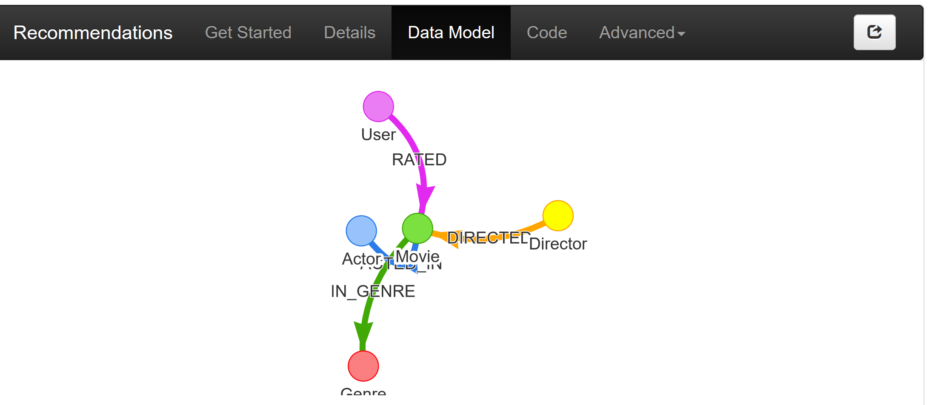
Movie Rating Sandbox

Slide 4
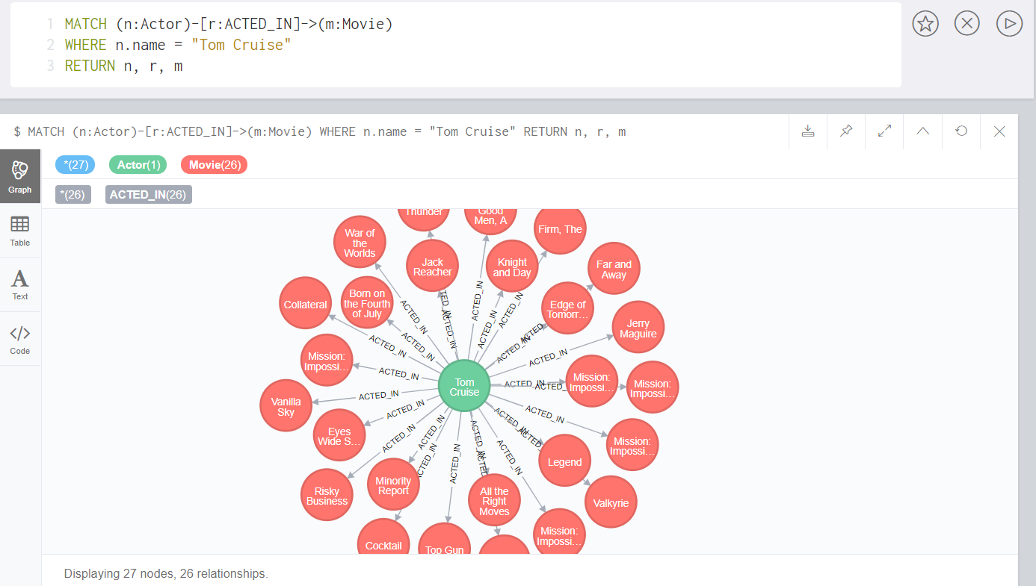
Cypher
MATCH : Used to specify the patterns to search for in the database.
WHERE: Adds constraints to the patterns in a MATCH or OPTIONAL MATCH clause or filters the results of a WITH clause.
RETURN: Defines what to include in the query result set.
match (n:Actor)-[r:ACTED_IN]->(m:Movie)
where n.name="Tom Cruise"
return n, r, m

Slide 5
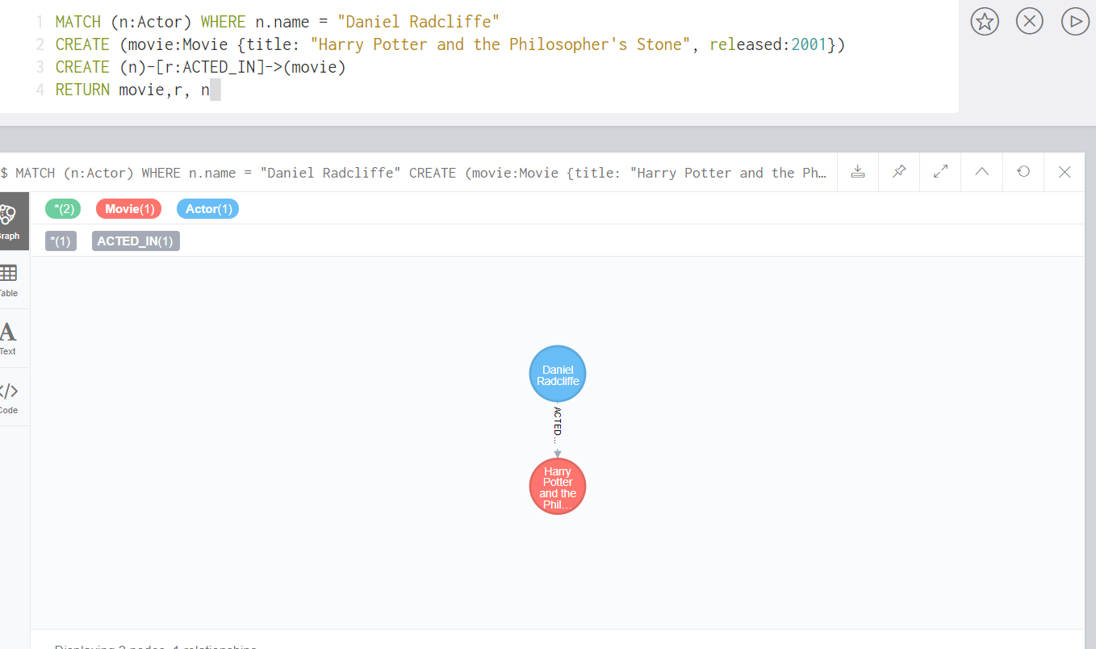
Cypher
CREATE : Create nodes and relationships.
We added a relationship for the actor Daniel Radcliffe.
Daniel Radcliffe – ACTED_IN -> Harry Potter and the Philosopher’s Stone
match (n:Actor) where n.name = "Daniel Radcliffe"
create (movie:Movie {title: "Harry Potter and the Philosopher’s Stone", released: 2001})
create (n)-[r:ACTED_IN]->(movie)
return movie,r,n

Slide 6
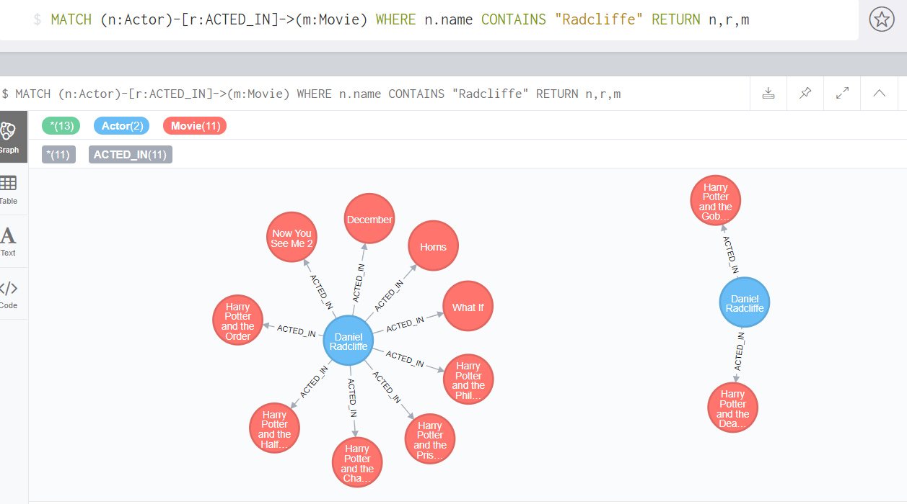
Cypher
MATCH : Used to specify the patterns to search for in the database.
WHERE: Adds constraints to the patterns in a MATCH or OPTIONAL MATCH clause or filters the results of a WITH clause.
RETURN: Defines what to include in the query result set.
Here, you can see all the movies where Daniel Radcliffe has acted in, including the node we added : Harry Potter and the Philosopher’s stone
match (n:Actor)-[r:ACTED_IN]->(m:Movie)
where n.name contains "Radcliffe"
return n, r, m

Slide 7
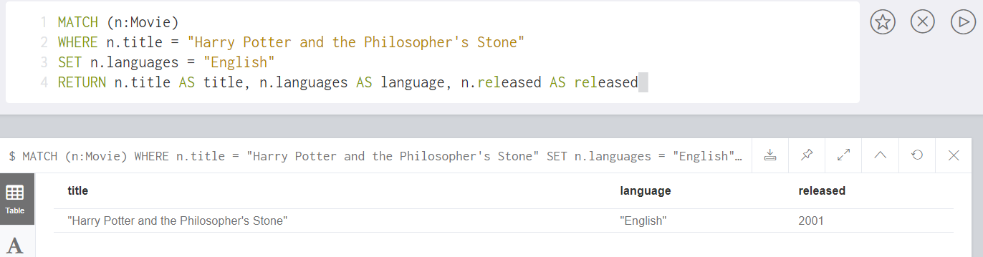
Cypher
SET : Update labels on nodes and properties on nodes and relationships.
Here we set the language as English for the movie Harry Potter and the Philosopher’s Stone.
match (n:Movie)
where n.title = "Harry Potter and the Philosopher's Stone"
set n.languages = "English"
return n.title as title, n.languages as language, n.released as released

Slide 8
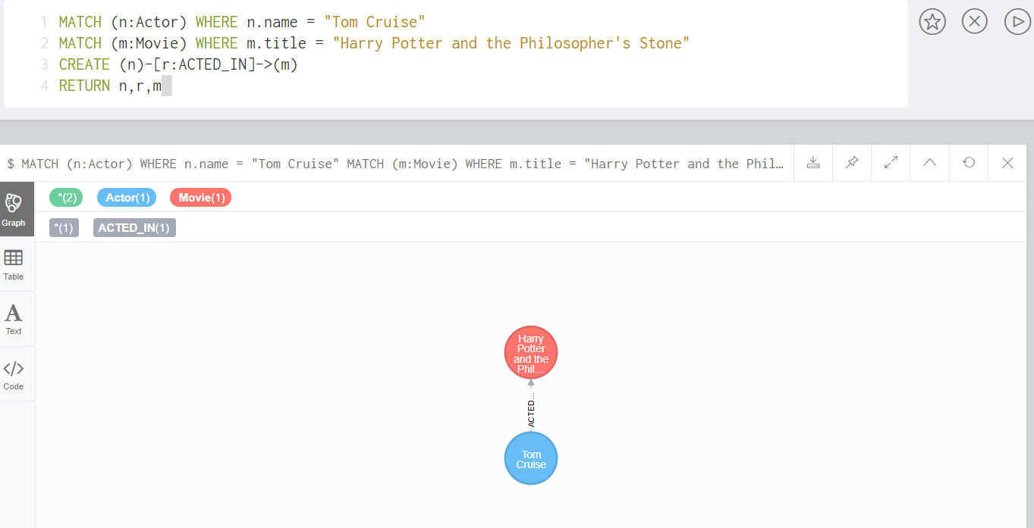
Cypher
Here we create a relationship between Tom Cruise and the movie Harry Potter and the Philosopher’s Stone.
We know that this relationship is False, and we will delete this in the next slide.
match (n:Actor) where n.mame = "Tom Cruise"
match (m:Movie) where m.title = "Harry Potter and the Philosopher's Stone"
create (n)-[r:ACTED_IN]->(m)
return n,r,m

Slide 9
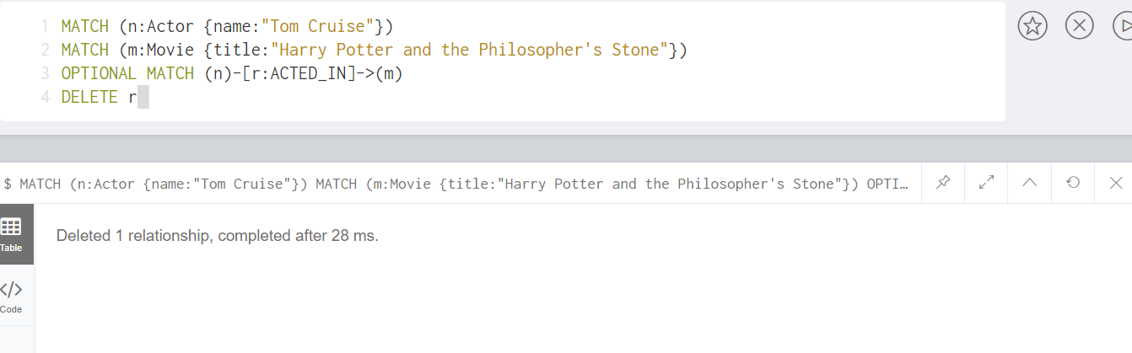
Cypher
OPTIONAL MATCH : Specify the patterns to search for in the database while using nulls for missing parts of the pattern.
DELETE : Delete nodes, relationships or paths. Any node to be deleted must also have all associated relationships explicitly deleted.
match (n:Actor {name: "Tom Cruise"})
match (m:Movie {title:"Harry Potter and the Philosopher's Stone"})
optional match (n)-[r:ACTED_IN]->(m)
delete r

Slide 10
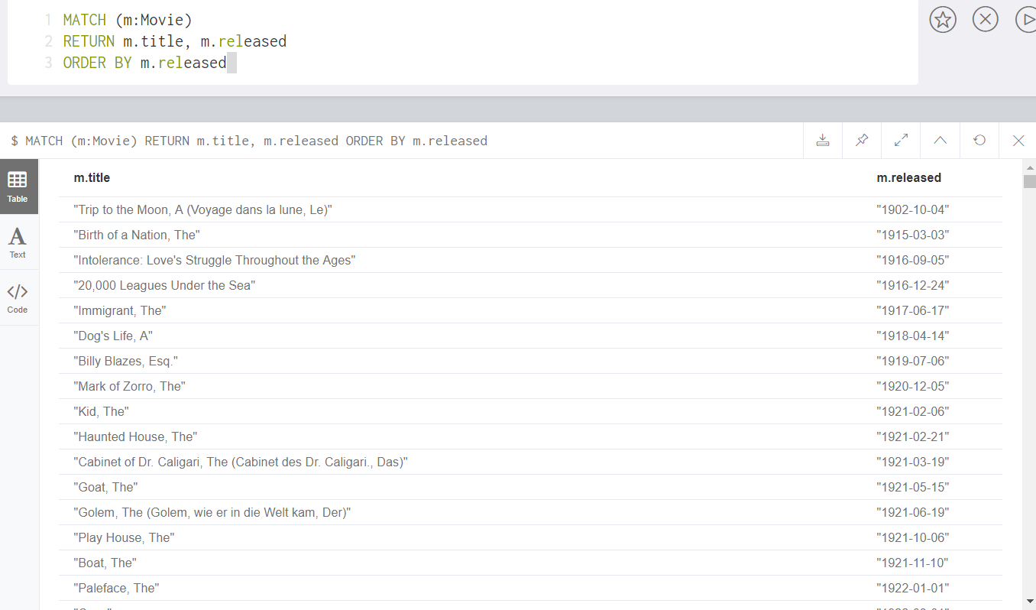
Cypher
ORDER BY : A sub-clause following RETURN or WITH, specifying that the output should be sorted in either ascending (the default) or descending order.
match (m:Movie)
return m.title, m.released
order by m.released

Slide 11
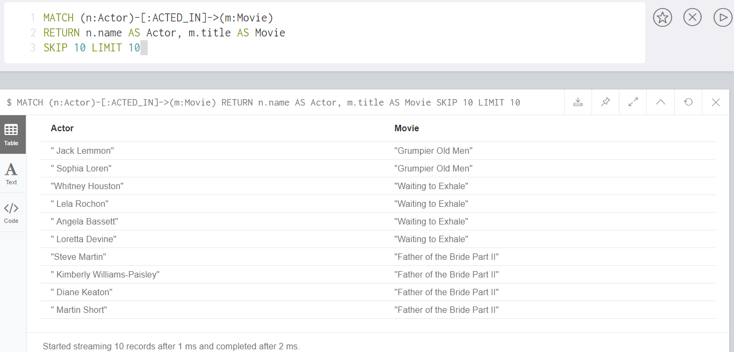
Cypher
SKIP : Defines from which row to start including the rows in the output.
LIMIT : Constrains the number of rows in the output.
match (n:Actor)-[:ACTED_IN]->(m:Movie)
return n.name as Actor, m.title as Movie
skip 10 limit 10

Slide 12
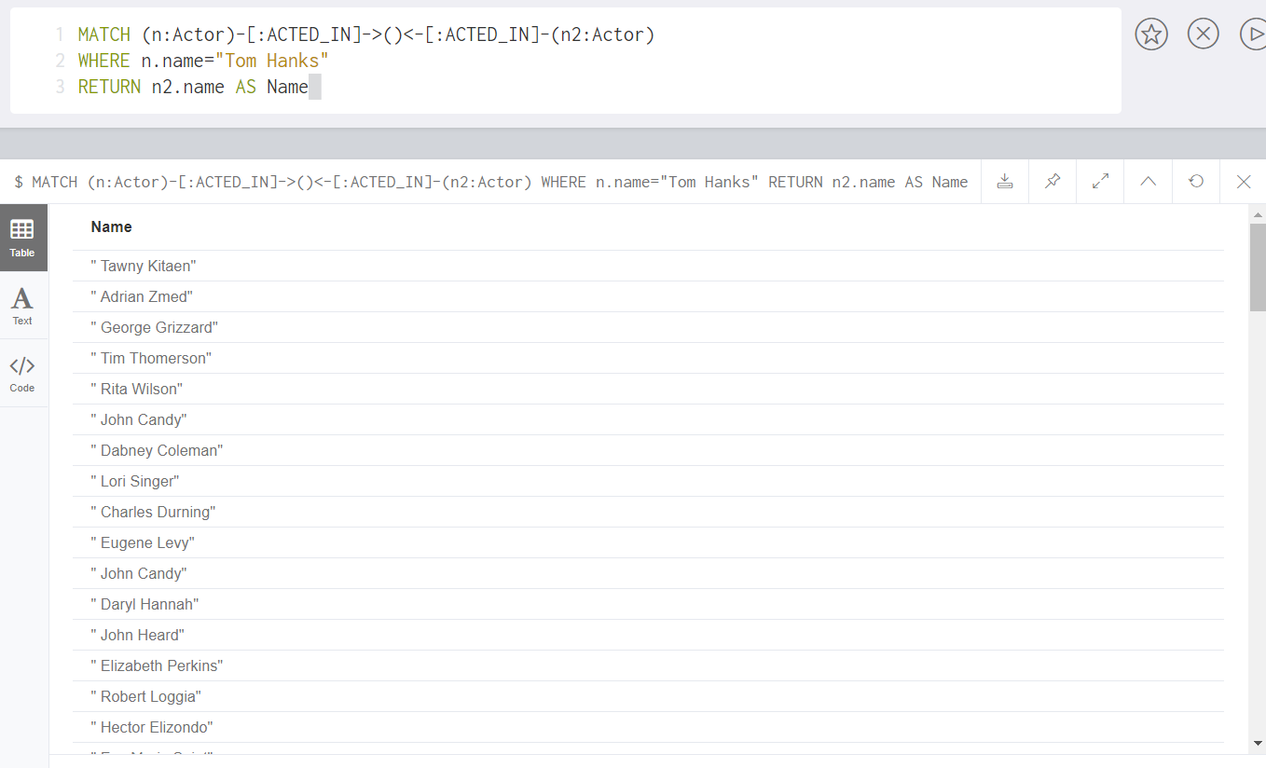
Cypher
Here, we have a query to see all actors who co-starred with Tom Hanks in his movies.
match (n:Actor)-[:ACTED_IN]->()<-[:ACTED_IN]-(n2:Actor)
where n.name = "Tom Hanks"
return n2.name as name

Slide 13
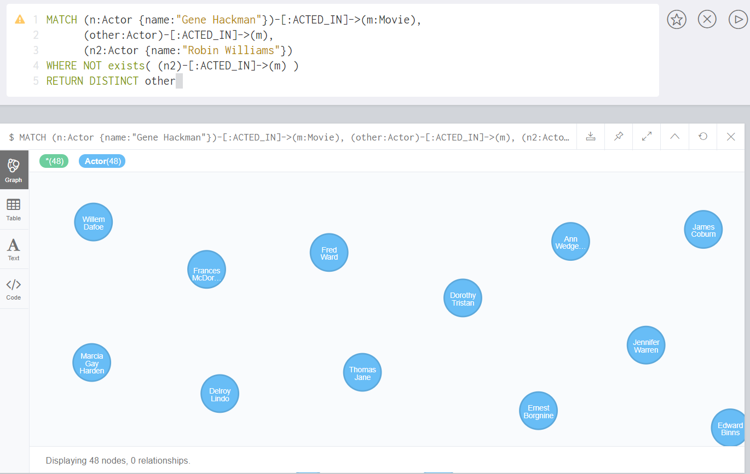
Cypher
Here, we use a combination of MATCH statements along with EXISTS statement to check actors who co-starred with Gene Hackman but not when Robin Williams co-starred with him.
DISTINCT is also used to return distinct names.
match (n:Actor {name:"Gene Hackman"})-[:ACTED_IN]->(m:Movie),
(other:Actor)-[:ACTED_IN]->(m),
(n2:Actor {name: "Robin Williams"})
where not exists ((n2)-[:ACTED_IN]->(m))
return distinct other

Slide 14
Cypher
Apart from these clauses, there are several other Cypher clauses and operators which can be explored on Neo4j’s site.
Please go through and explore the same using the link given below:
https://neo4j.com/docs/developer-manual/current/cypher/clauses/
Also, we will see some other operators and clauses in the upcoming examples as well.

Slide 15
Offshore Leaks Database (ICIJ)
The Offshore Leaks Database is a graph database powered by Neo4j and provided by The International Consortium of Investigative Journalists.
This ICIJ database contains information on more than 785,000 offshore entities that are part of the Panama Papers, the Offshore Leaks, the Bahamas Leaks and the Paradise Papers investigations.
The data covers nearly 80 years up to 2016 and links to people and companies in more than 200 countries and territories.

Slide 16
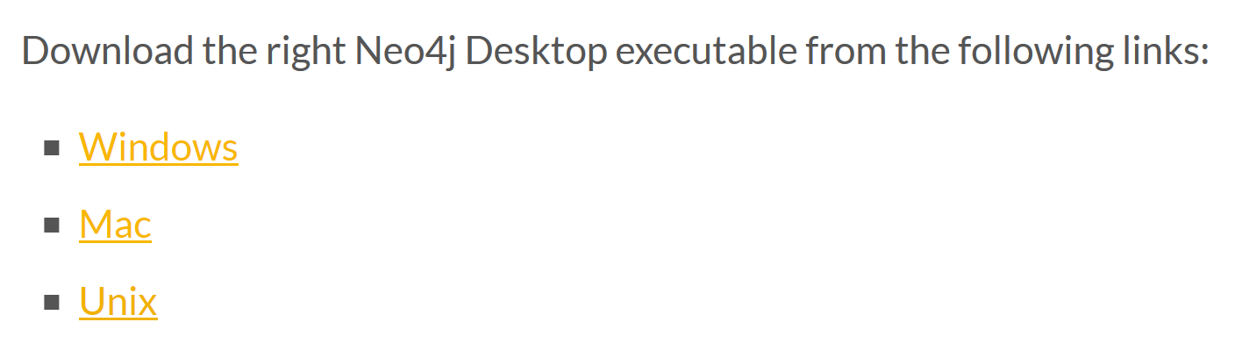



Offshore Leaks Database (ICIJ)
The database on Neo4j (consisting of the Paradise Papers) can be downloaded from the following link:
https://offshoreleaks.icij.org/pages/database
The link also consists of zip files containing csv files for the Paradise Papers, Panama Papers, Offshore Leaks and Bahama Leaks.

Slide 17
ICIJ Neo4J desktop download
https://neo4j.com/blog/icij-releases-neo4j-desktop-download-paradise-papers/
Or go to canvas to unzip the file and install the desktop version

Slide 18
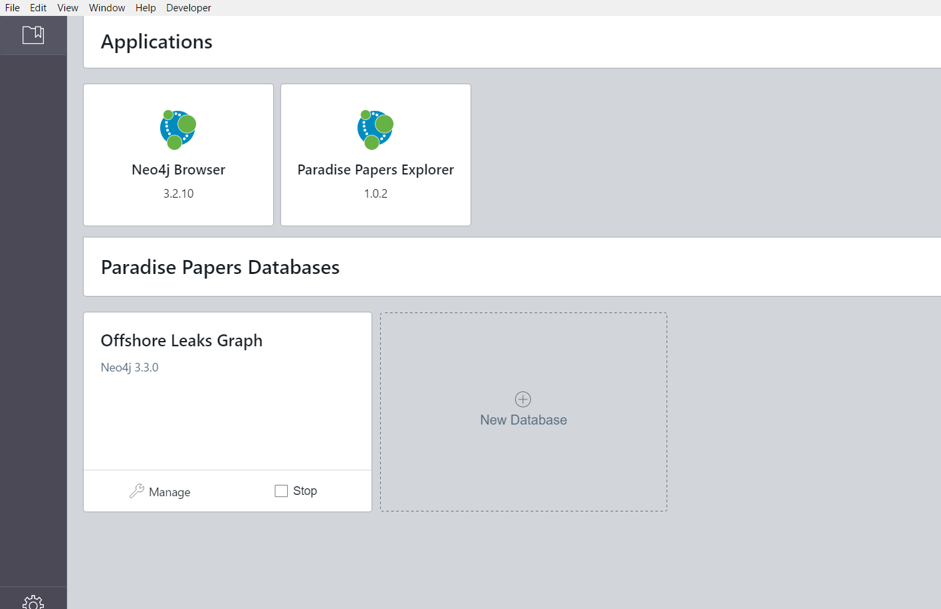
Neo4j for ICIJ : Paradise Papers
The Neo4j Desktop for ICIJ will look as follows. It consists of the Offshore Leaks Graph Database as well as a special explorer for the Paradise Papers.

Slide 19
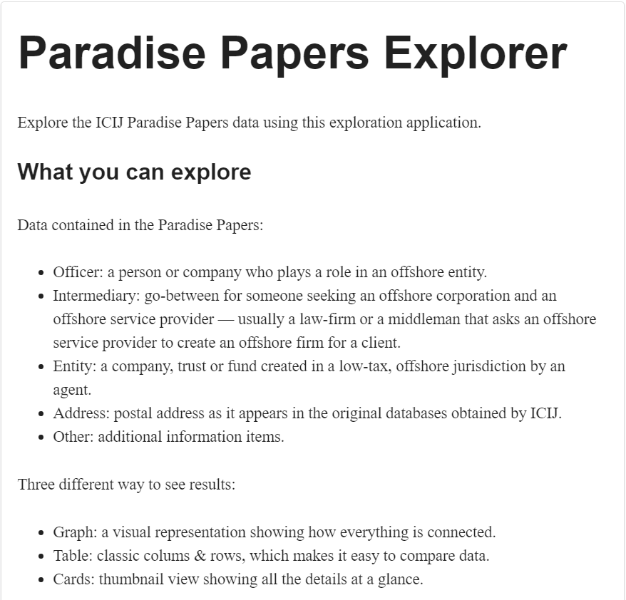
Paradise Papers
We will now use the Paradise Papers Explorer and the Offshore Leaks Database to explore some of the connections in the Paradise Paper Graph database.
We will also look at connections of specific political figures present in the Paradise and Panama Papers (mentioned by Neo4j contributor Michael Hunger in his blogs on the Panama and Paradise papers)
Given below are the label conventions for the Paradise and Panama Papers.
Credits: https://neo4j.com/blog/depth-graph-analysis-paradise-papers/

Slide 20
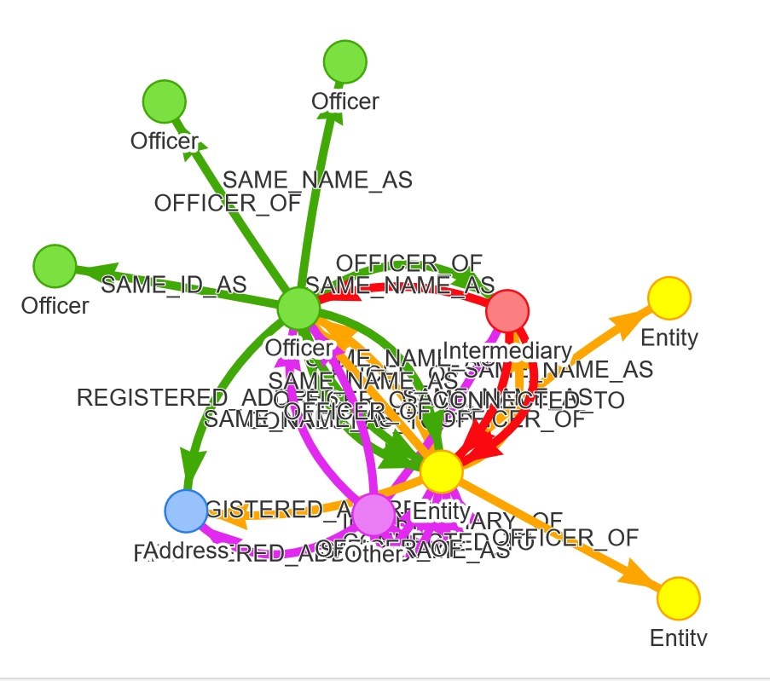
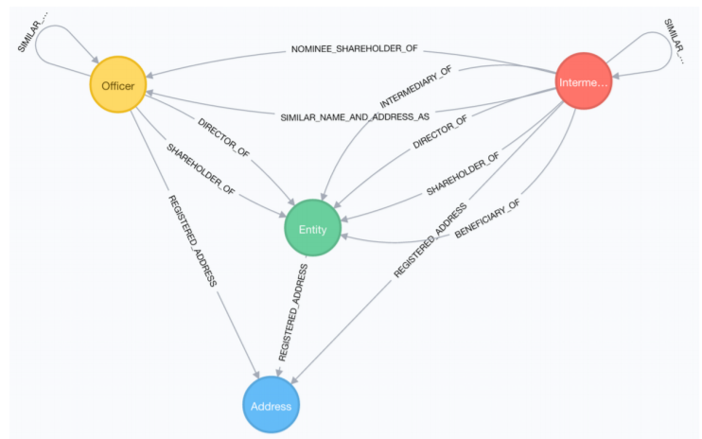
Paradise Papers
Given below is the basic ICIJ data model used in the Offshore Leaks Graph database.

Slide 21
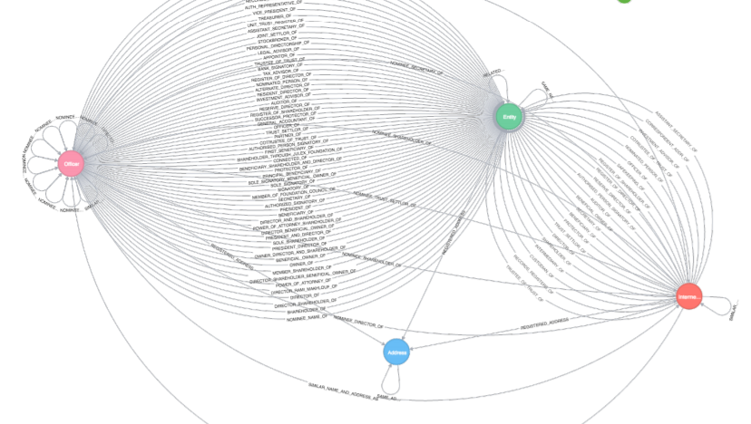
Paradise Papers
And the complete ICIJ data model!

Slide 22
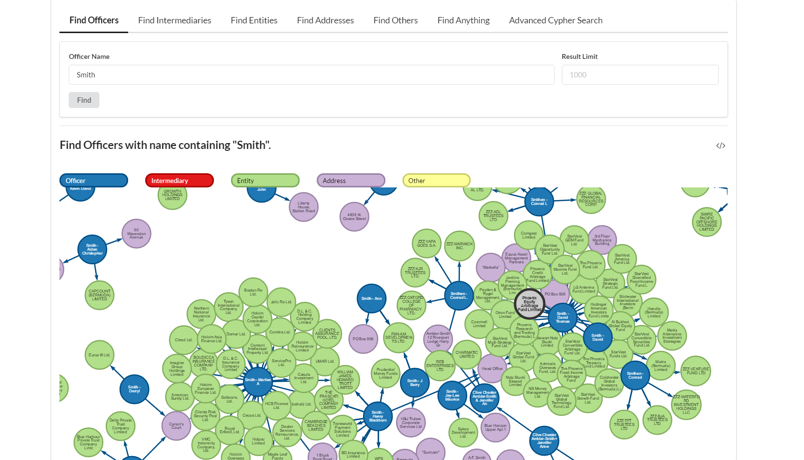
Paradise Papers
Given below is a snapshot of the Neo4j Paradise Paper Explorer. Here you can directly search for specific Officers, Intermediaries, Addresses and also run specific Cypher queries.

Slide 23
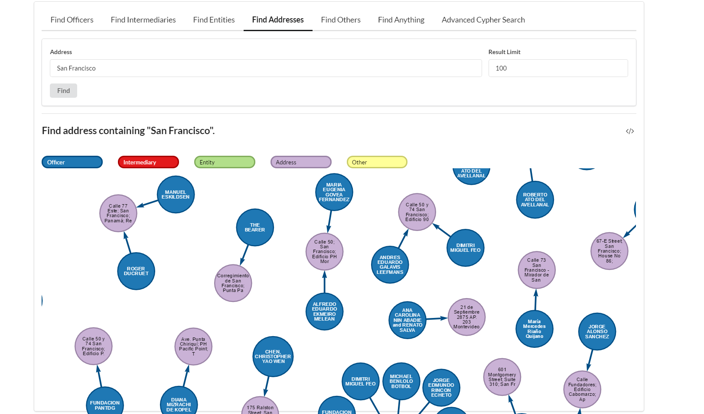
Paradise Papers
Given below is a snapshot of the Neo4j Paradise Paper Explorer. Here you can directly search for specific Officers, Intermediaries, Addresses and also run specific Cypher queries.

Slide 24
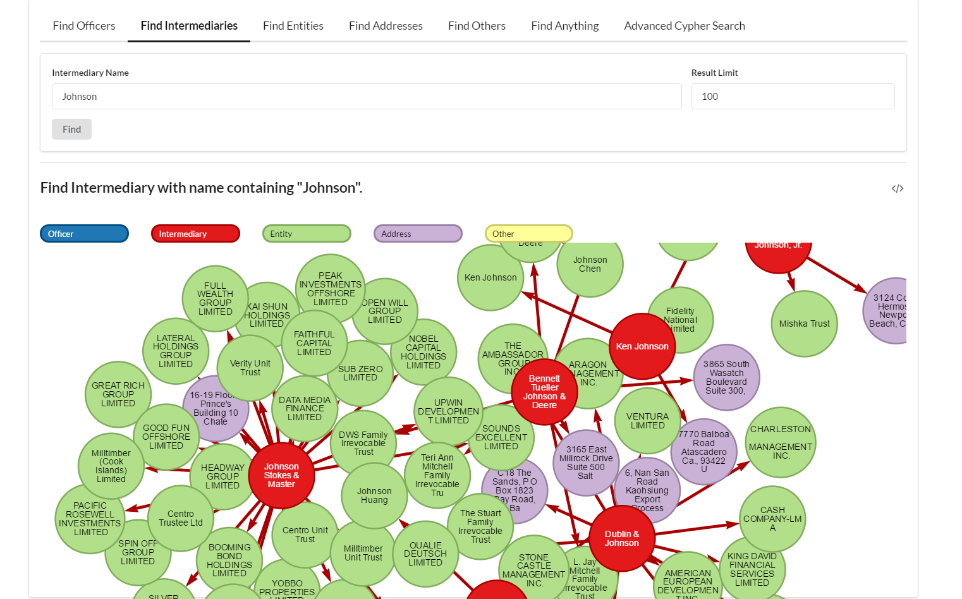
Paradise Papers
Given below is a snapshot of the Neo4j Paradise Paper Explorer. Here you can directly search for specific Officers, Intermediaries, Addresses and also run specific Cypher queries.

Slide 25
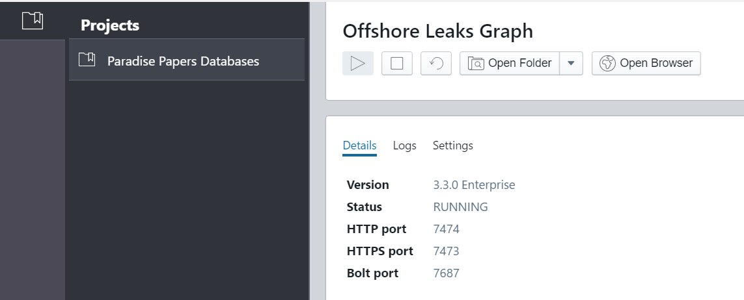
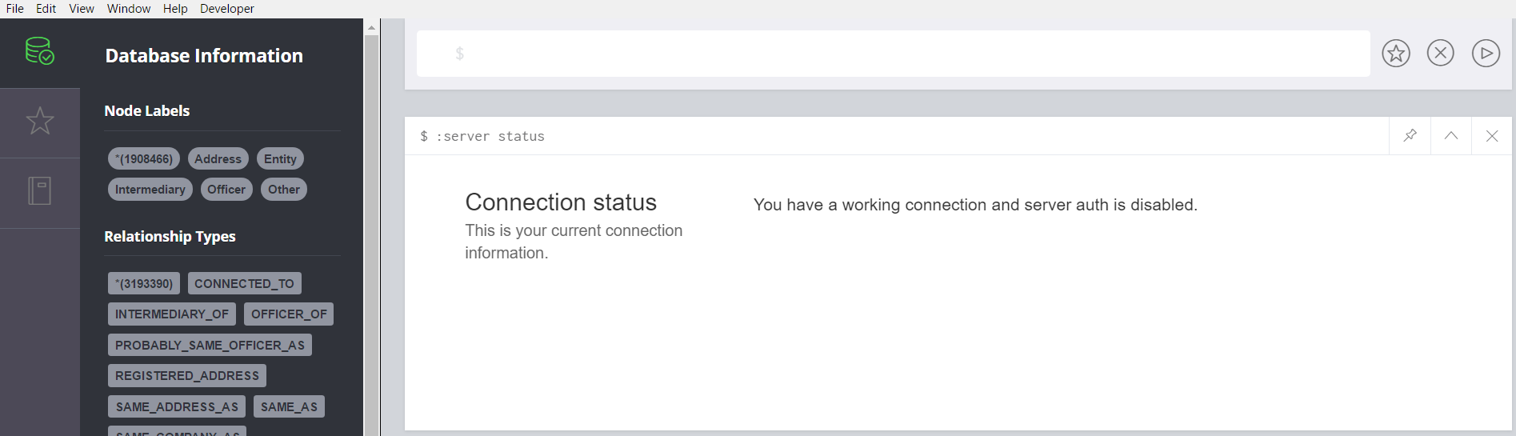
Paradise Papers
You can use the Offshore Leaks Graph database by clicking on “Manage”.
Now click “Open Browser” to open the Neo4j browser and execute queries.

Slide 26
Apoc: neo4j procedure libraries
Graph algorithms
Metadata
Manual indexes and relationship indexes
Full text search
Integration with other databases like MongoDB, ElasticSearch, Cassandra and relational databases
Loading of XML and JSON from APIs and files
Collection and map utilities
Date and time functions
String and text functions
Import and export
Concurrent and batched Cypher execution
Spatial functions
Path expansion
https://neo4j.com/blog/intro-user-defined-procedures-apoc/

Slide 27
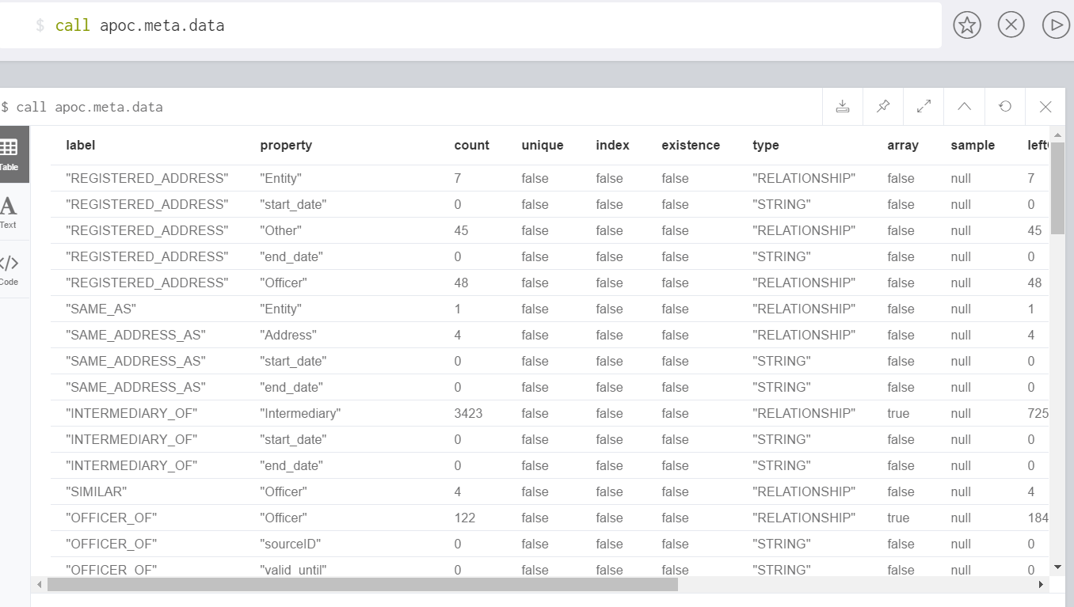
Paradise Papers
We can use the following apoc (awesome procedures on cypher) command in order to view all the metadata for the database.
We can see the labels, properties, types, etc. in the database using this command.

Slide 28
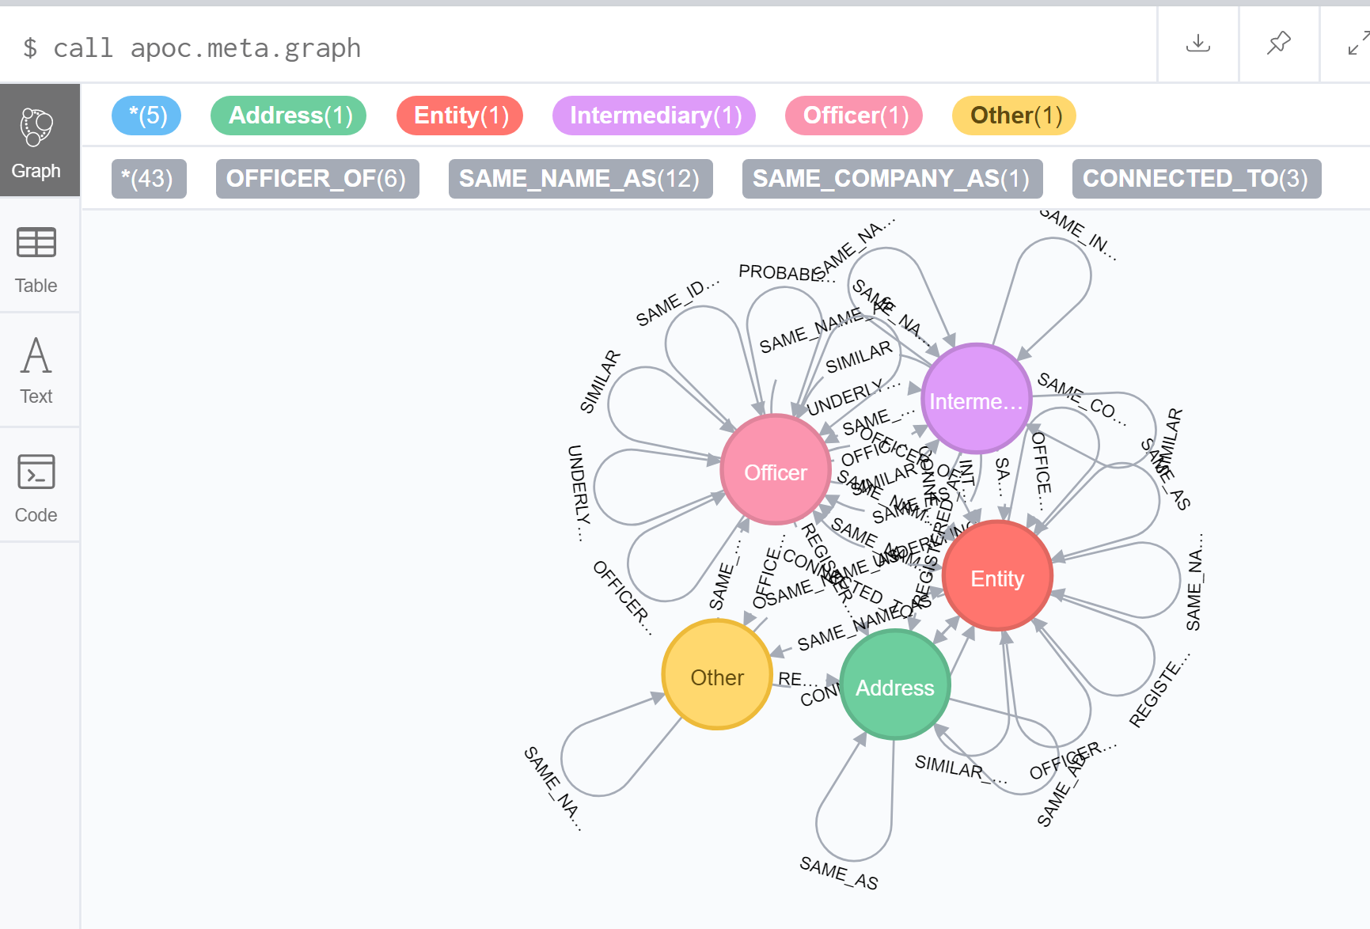
Paradise Papers

Slide 29
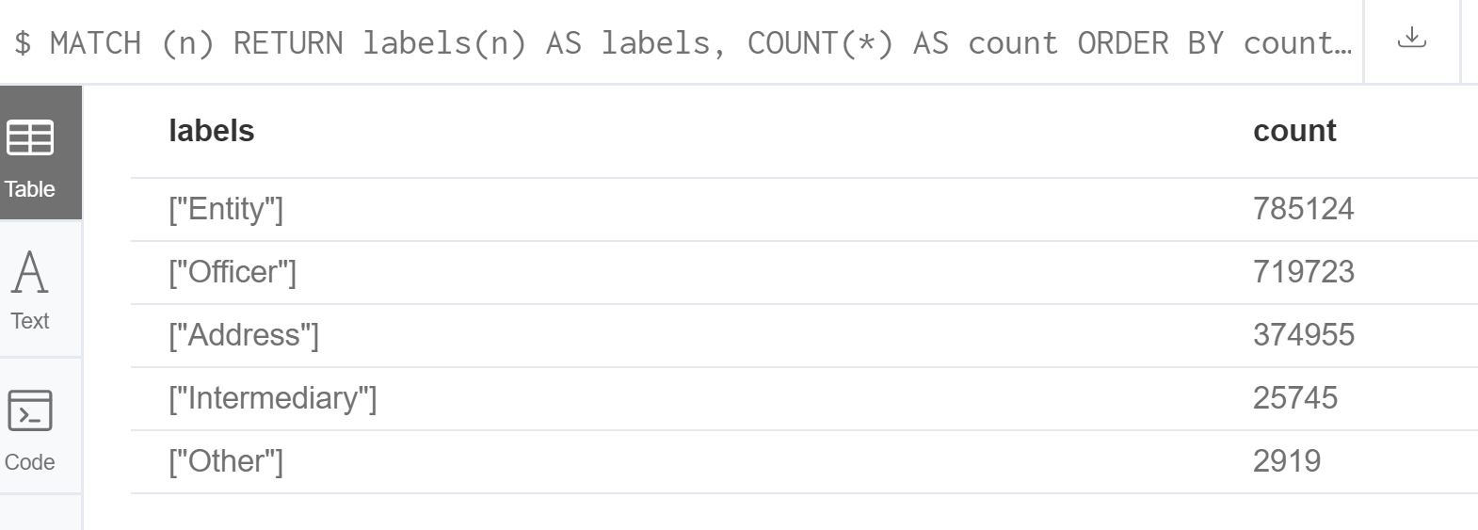
Paradise Papers
Using this statement, we obtain all the labels in the database and their respective counts.
MATCH (n) RETURN labels(n) AS labels, COUNT(*) AS count ORDER BY count DESC

Slide 30
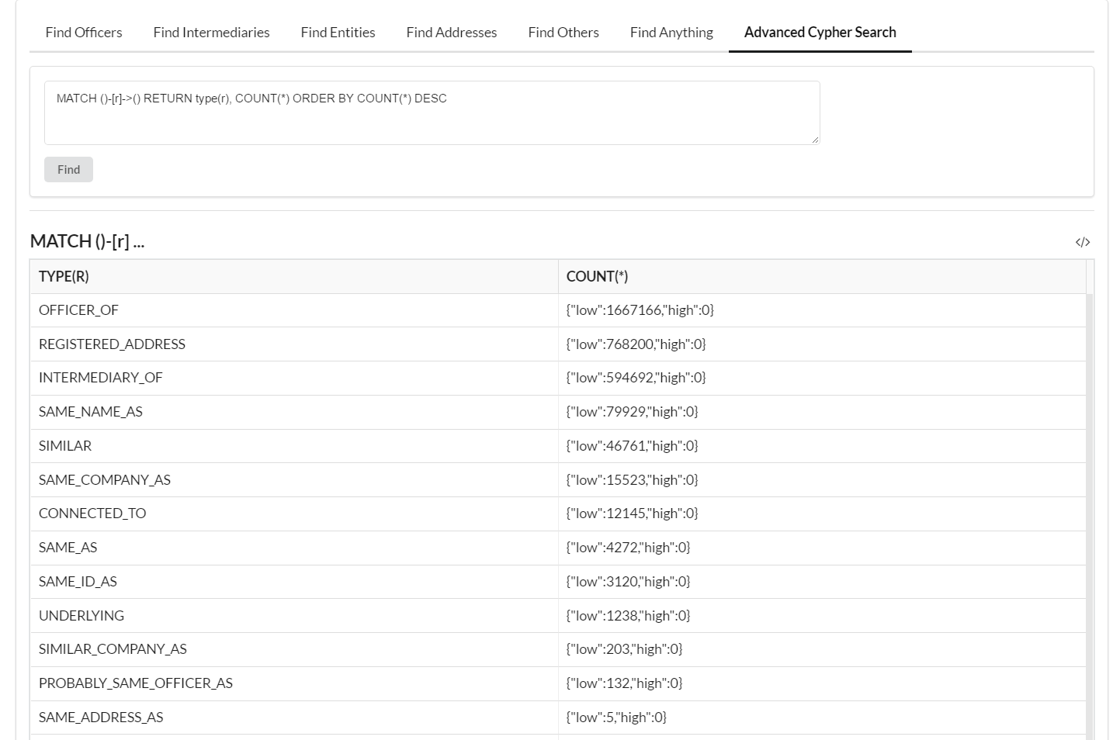
Paradise Papers
This statement is used to obtain all types of relationships in the database, ordered by their counts.
MATCH ()-[r]->() RETURN type(r), COUNT(*) ORDER BY COUNT(*) DESC

Slide 31
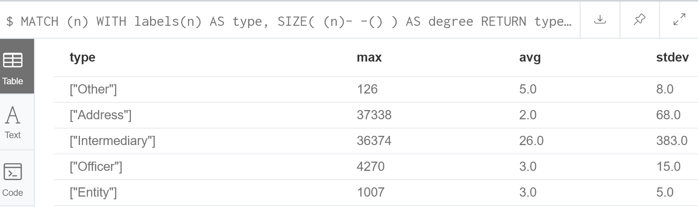
Paradise Papers
This statement is used to provide the maximum, average and standard deviation of the degree of all node labels in the database.
MATCH (n) WITH labels(n) AS type, SIZE( (n)- -() ) AS degree RETURN type, MAX(degree) AS max, ROUND(AVG(degree)) AS avg, ROUND(STDEV(degree)) AS stdev

Slide 32
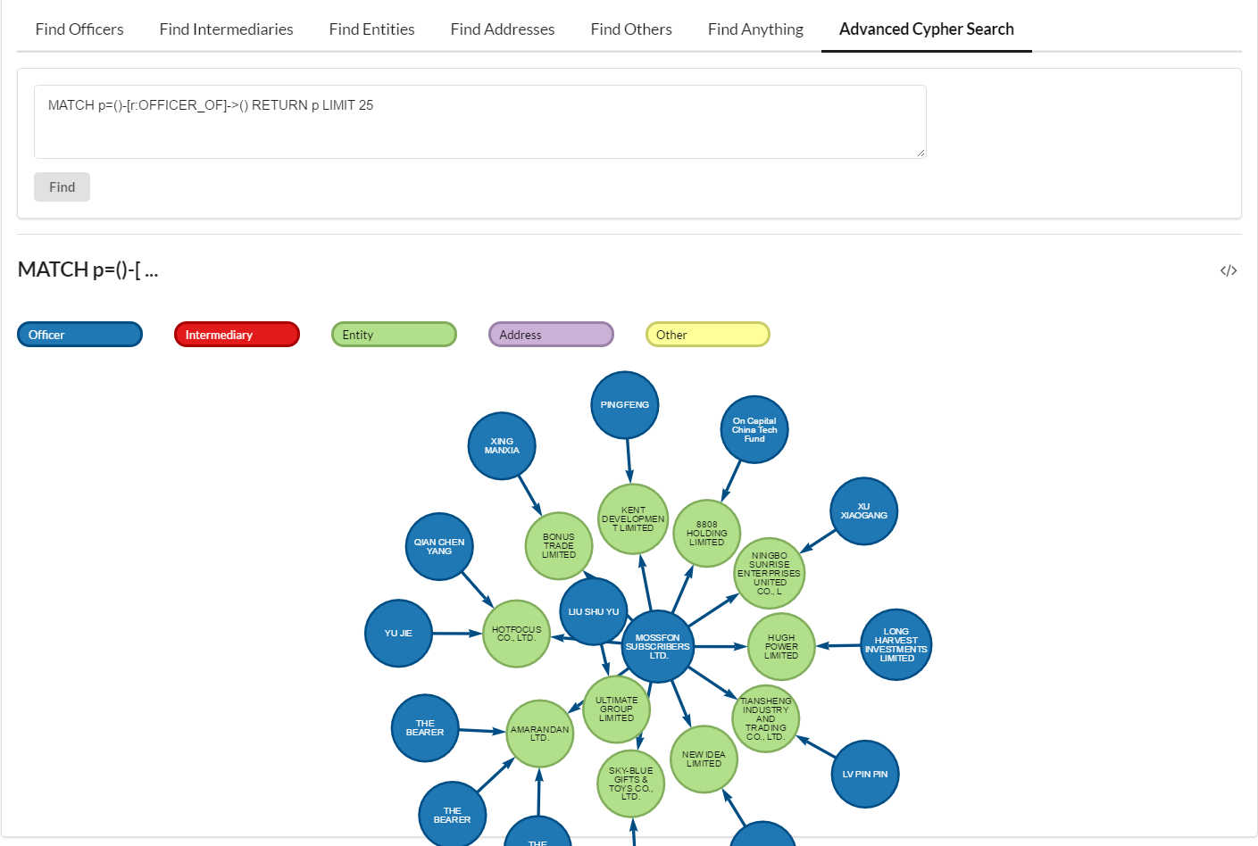
Paradise Papers
We use this statement to explore all possible relationships between Officers and Entities, etc.
MATCH p=()-[r:OFFICER_OF]->() RETURN p LIMIT 25

Slide 33
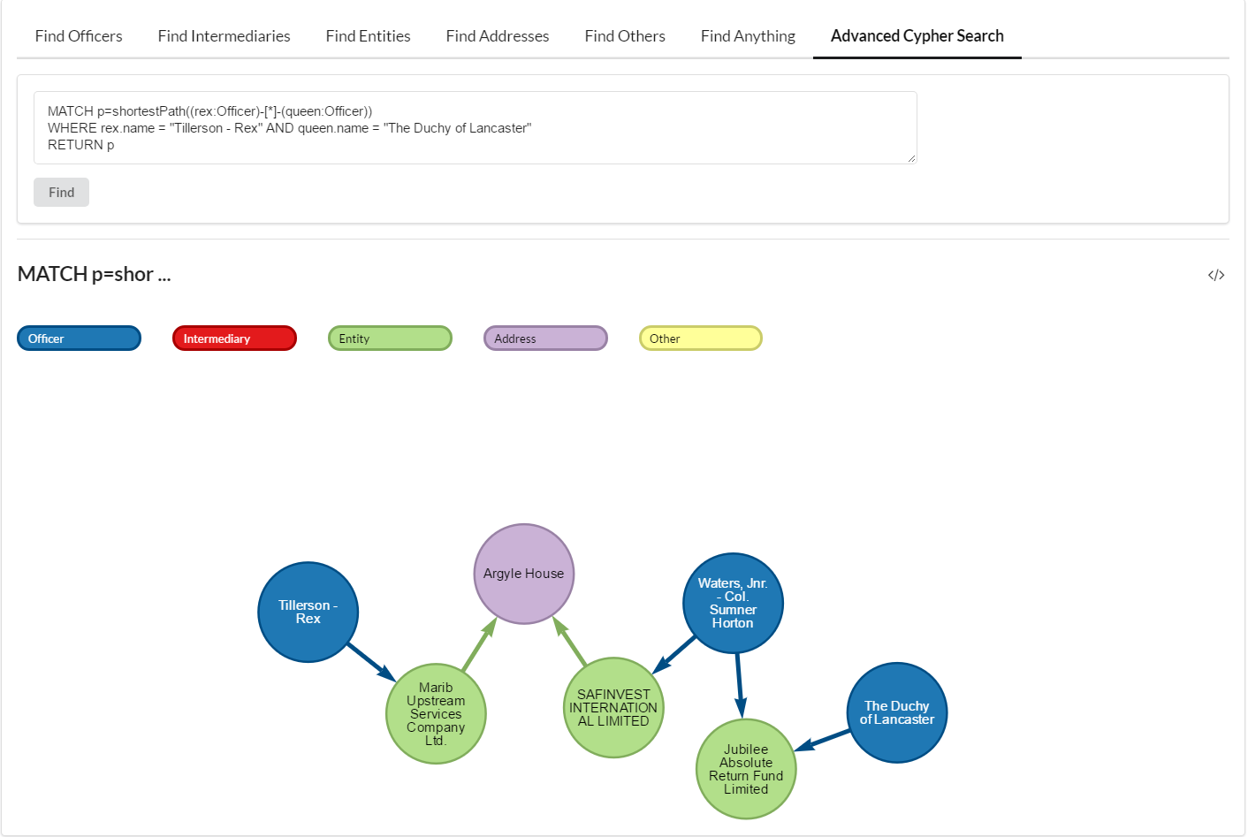
Paradise Papers
Here, we examine the relations between Rex Tillerson, the ex-U.S. Secretary of State who had connections to a Bermuda-based oil and gas company with operations in Yemen, and the Queen of England, whose estate, it was reported, was an investor in a Bermuda-based company.
MATCH p = shortestPath((rex: Officer)-[*]-(queen:Officer)) WHERE rex.name = "Tillerson - Rex" AND queen.name = "The Duchy of Lancaster" RETURN p

Slide 34
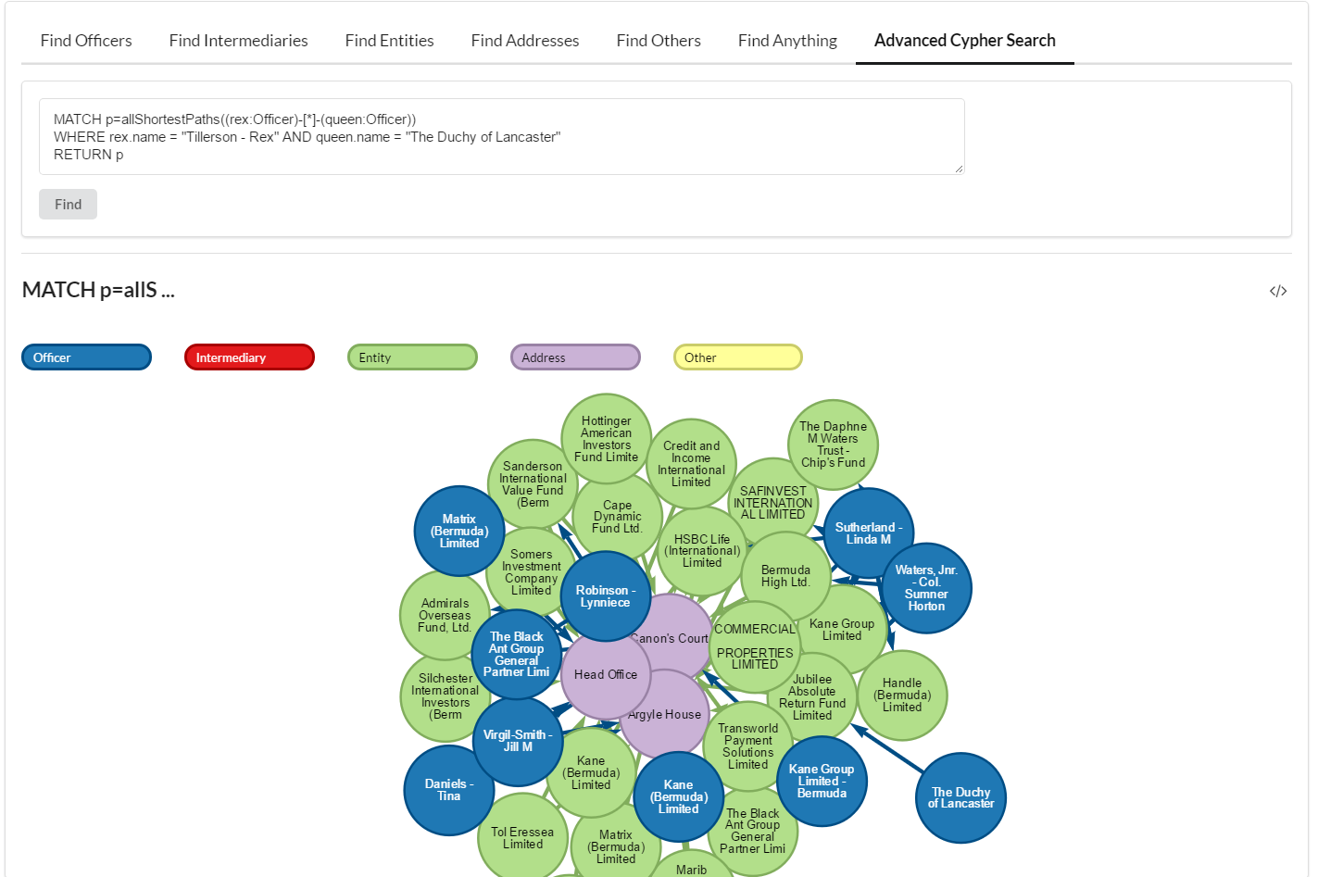
Paradise Papers
Similar to the previous query, except here we explore all possible shortest paths between Rex Tillerson and the Queen of England.
Note: Please retype the dash and quotation marks For Tillerson Rex.
MATCH p=allShortestPaths((rex:Officer)-[*]-(queen:Officer)) WHERE rex.name = "Tillerson - Rex" AND queen.name = "The Duchy of Lancaster" RETURN p

Slide 35
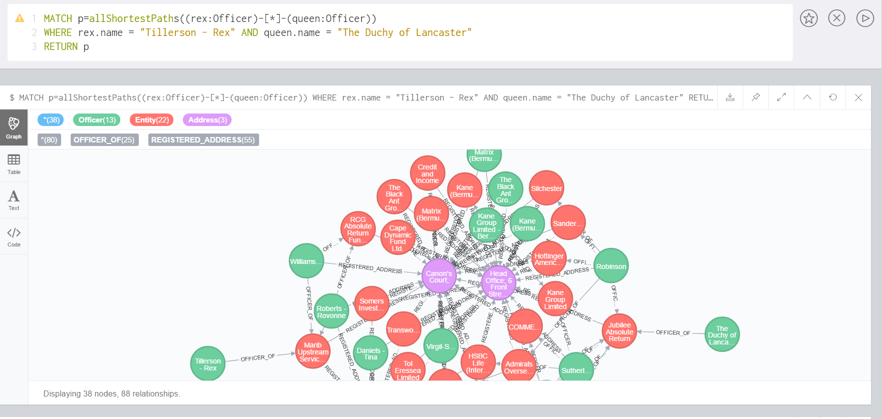
Paradise Papers
Here we execute the same query as on the previous slide but through the Offshore Leaks database on the Neo4j browser, instead of on the Paradise Papers Explorer.

Slide 36
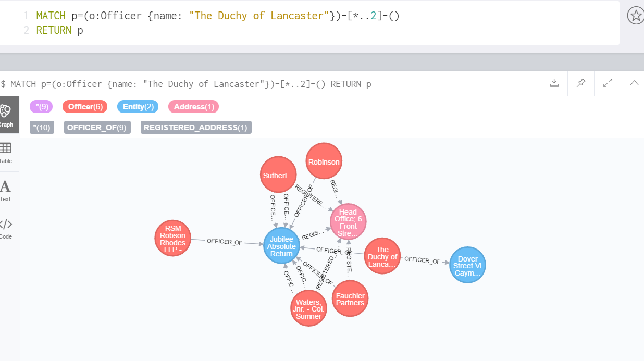
Paradise Papers
Here, we explore all the second degree connections to the Queen of England’s private estate – The Duchy of Lancaster.
MATCH p=(o:Officer {name:"The Duchy of Lancaster"})-[*..2]-() RETURN p

Slide 37
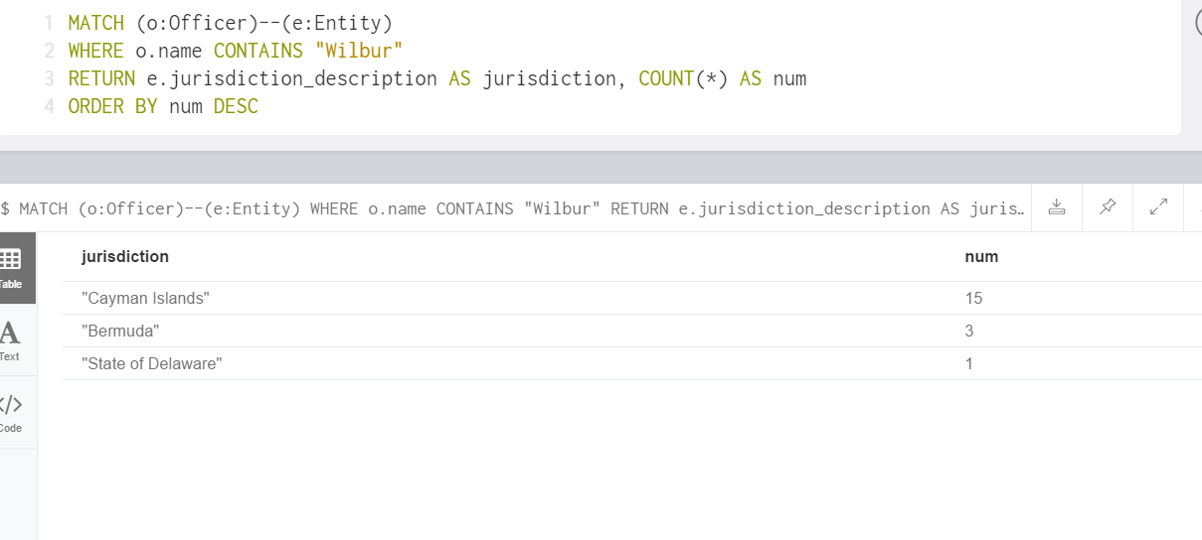
Paradise Papers
Here, we explore the offshore connections of US Secretary of Commerce, Wilbur Ross, by jurisdiction.
MATCH (o:Officer)- -(e:Entity) WHERE o.name CONTAINS "Wilbur" RETURN e.jurisdiction_description AS jurisdiction, COUNT(*) AS num ORDER BY num DESC

Slide 38
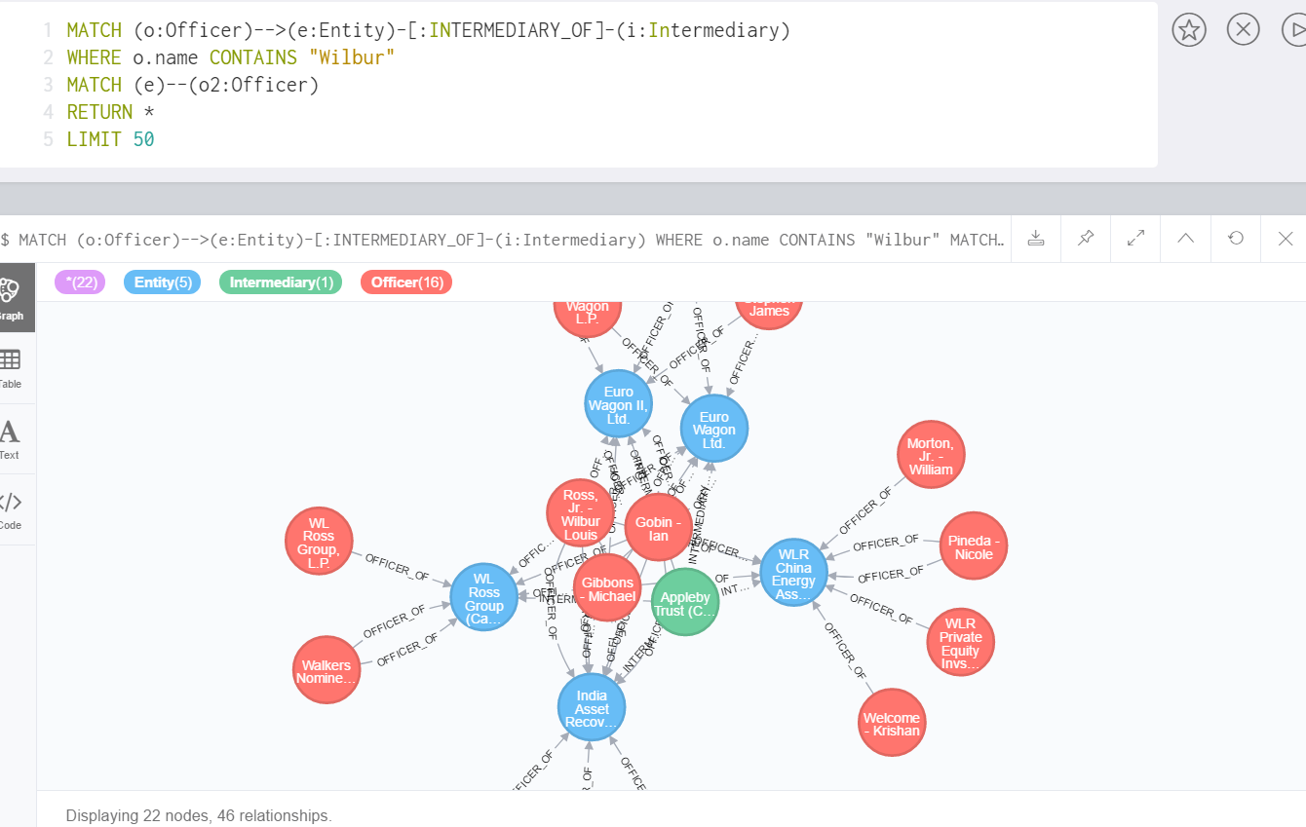
Paradise Papers
Here, we further explore offshore connections of Wilbur Ross (including offshore entities and intermediaries)
MATCH (o:Officer) - -> (e:Entity) – [:INTERMEDIARY_OF] – (i:Intermediary) WHERE o.name CONTAINS "Wilbur" MATCH (e) - - (o2:Officer) RETURN * LIMIT 50

Slide 39
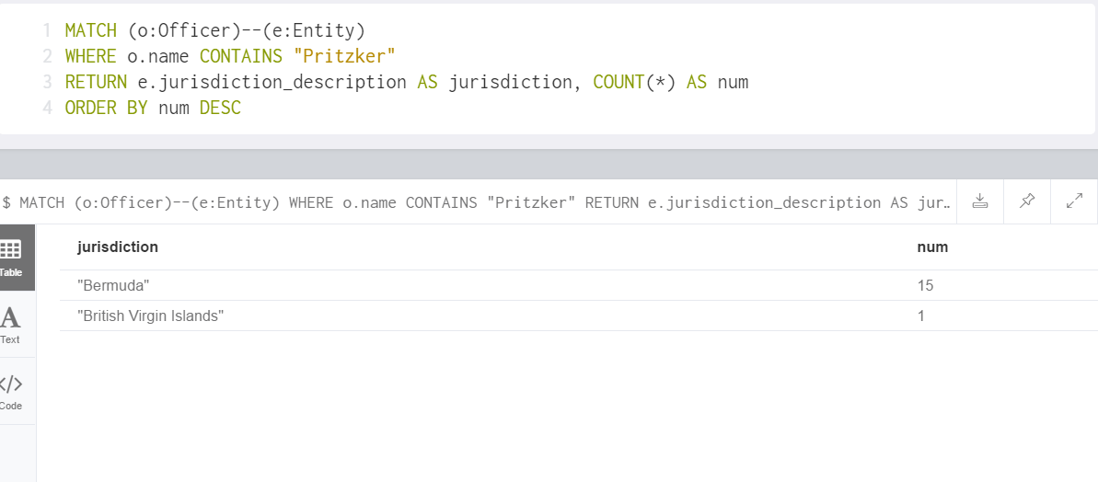
Paradise Papers
In this query, we explore offshore connections of American venture capitalist, entrepreneur and politician J.B. Pritzker.
MATCH (o:Officer) - - (e:Entity) WHERE o.name CONTAINS "Pritzker" RETURN e.jurisdiction_description AS jurisdiction, COUNT(*) AS num ORDER BY num DESC

Slide 40
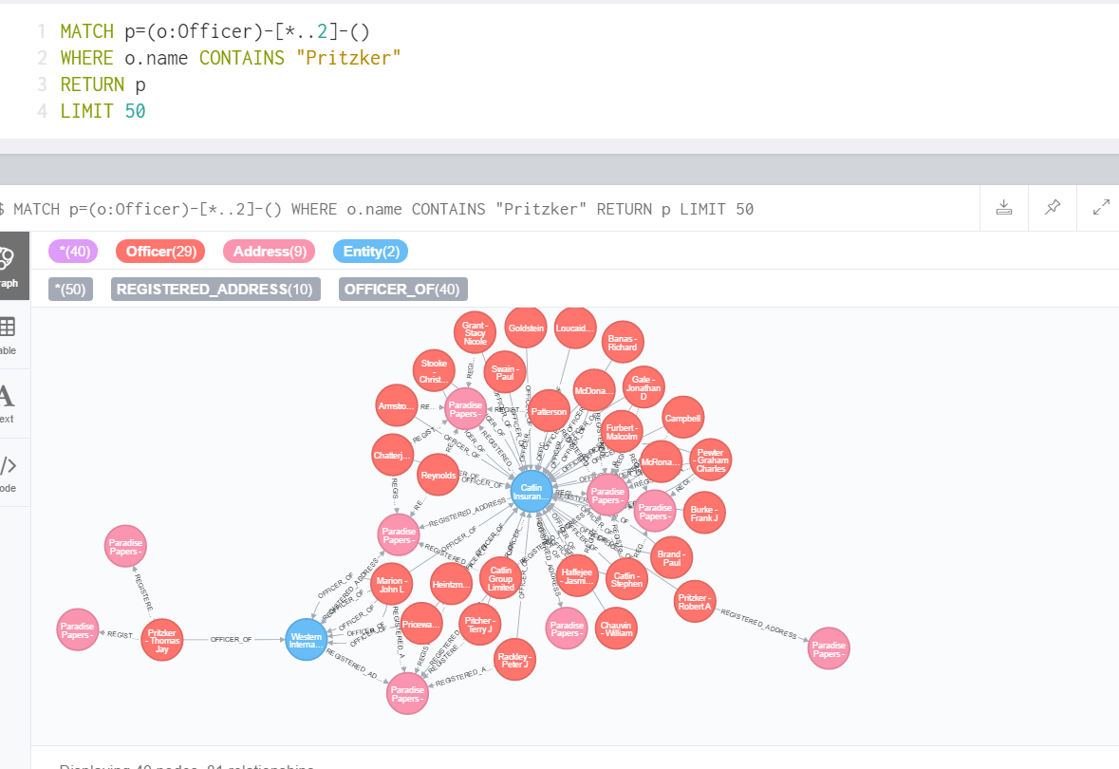
Paradise Papers
Here, we explore further second degree connections of J.B. Pritzker.
MATCH p=(o:Officer) – [*..2] – () WHERE o.name CONTAINS "Pritzker" RETURN p LIMIT 50

Slide 41
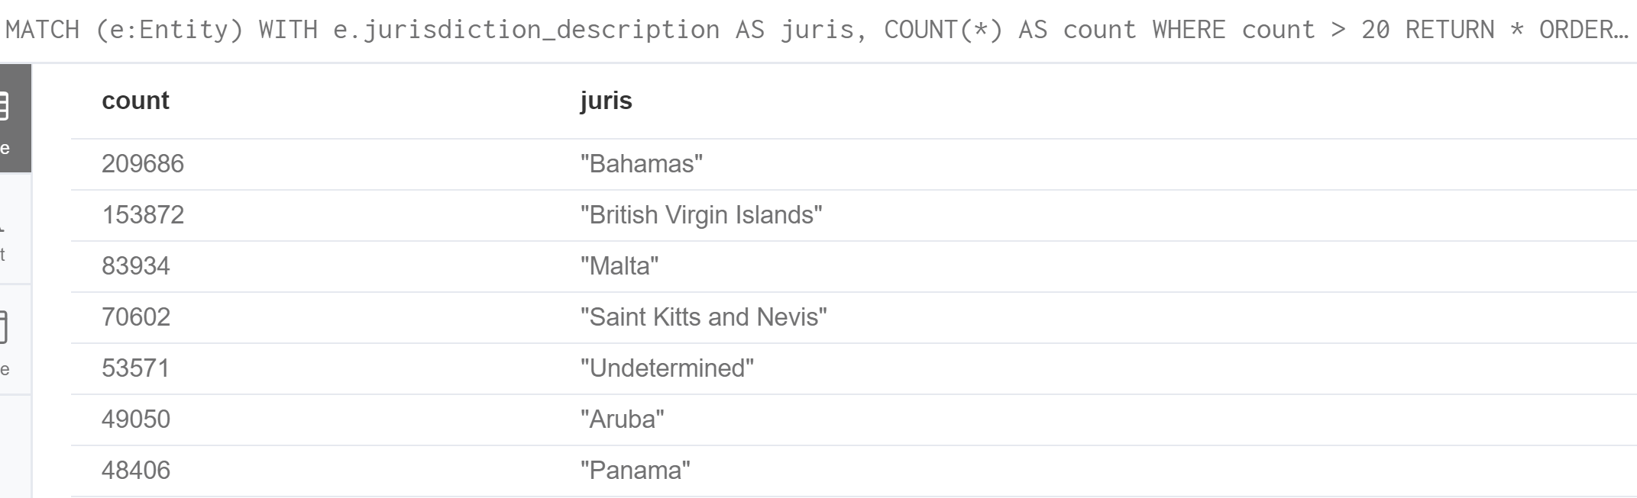
Paradise Papers
Using this query we obtain offshore entity counts by jurisdiction. We can use this to get a distribution of all jurisdictions and identify potential enablers.
MATCH (e:Entity) WITH e.jurisdiction_description AS juris, COUNT(*) AS count WHERE count > 20 RETURN * ORDER BY count DESC

Slide 42
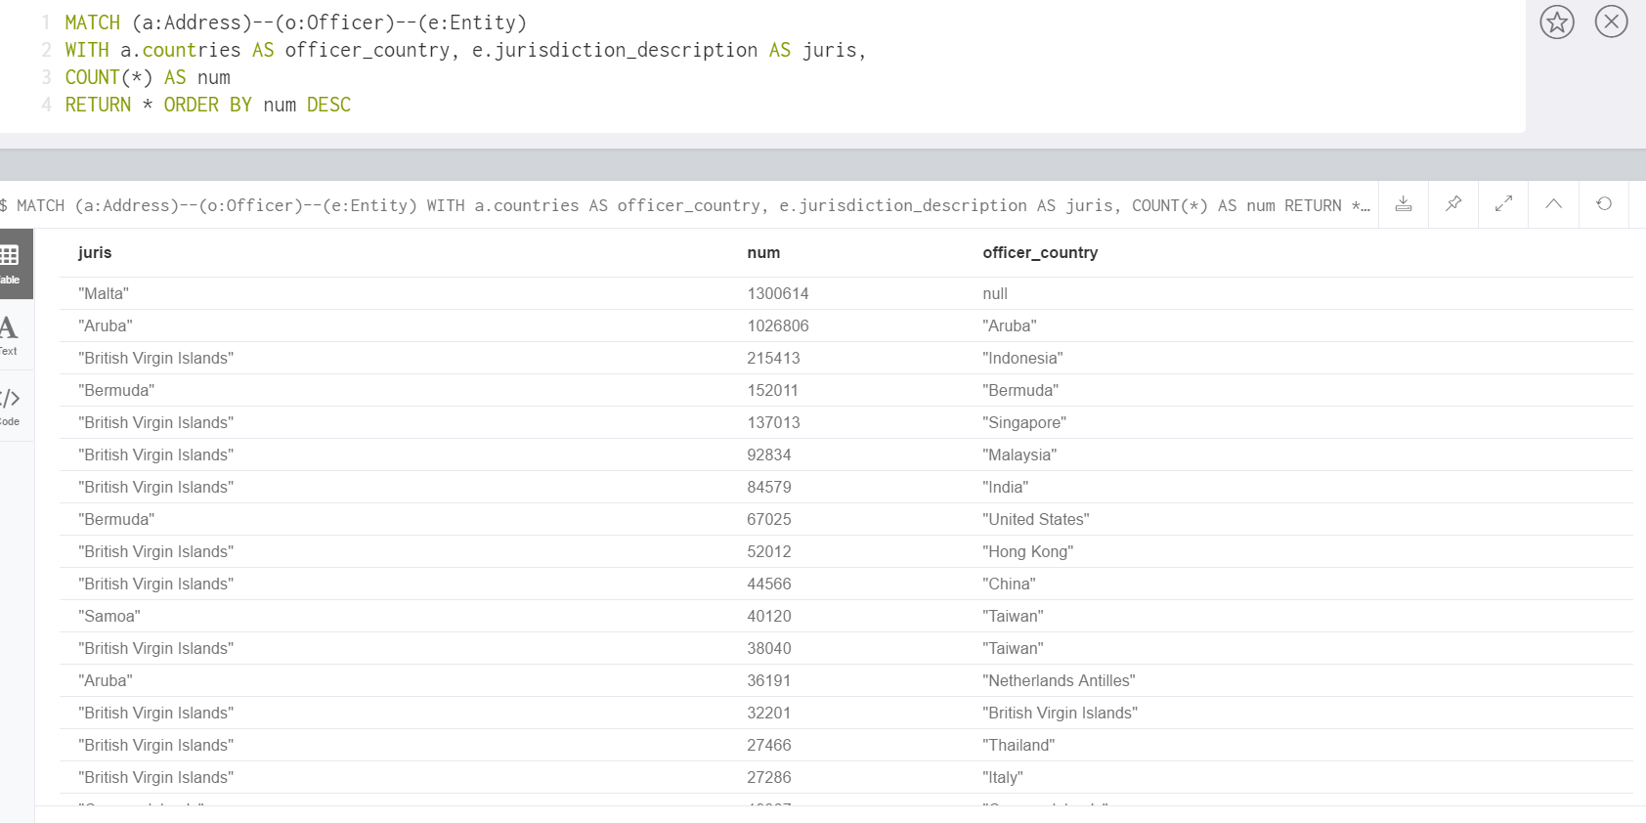
Paradise Papers
The distribution given by this query informs us of the most popular jurisdictions chosen by officers (beneficiaries) from different countries.
MATCH (a:Address) - - (o:Officer) - - (e:Entity) WITH a.countries AS officer_country, e.jurisdiction_description as juris, COUNT(*) AS num RETURN * ORDER BY num DESC

Slide 43
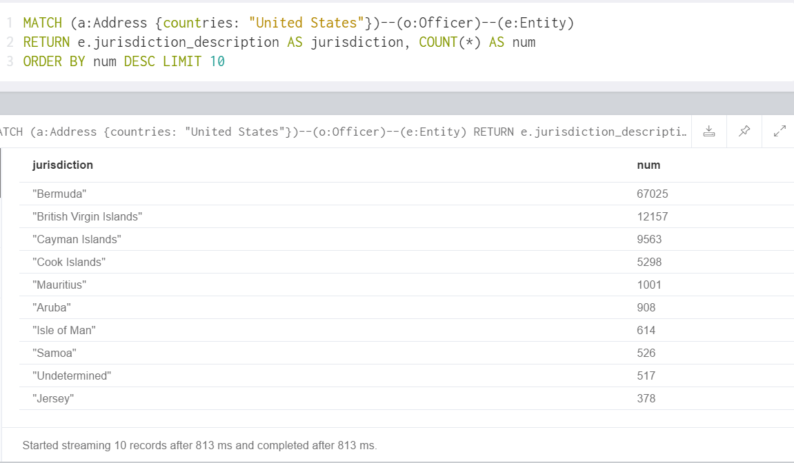
Paradise Papers
Using this query, we can see the jurisdiction distribution specifically for users/Officers with an address in the United States.
MATCH (a:Address {countries: "United States"}) - - (o:Officer) - - (e:Entity) RETURN e.jurisdiction_description AS jurisdiction, COUNT(*) AS num ORDER BY num DESC LIMIT 10

Slide 44
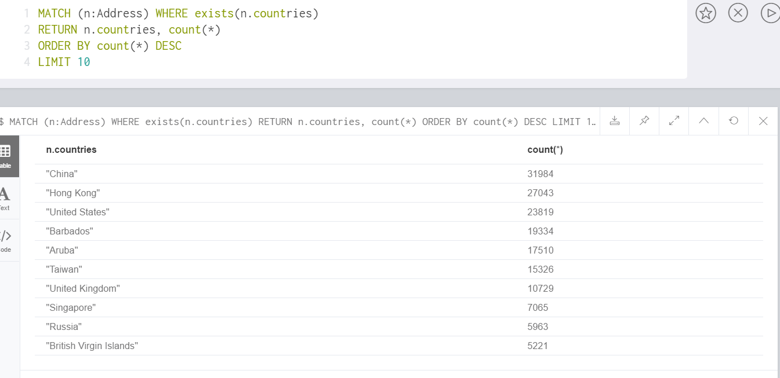
Paradise Papers
Using this query, we can obtain the distribution of all countries (where we see registered addresses of Officers) in the Paradise Papers.
MATCH (n:Address) WHERE EXISTS(n.countries) RETURN n.countries, count(*) ORDER BY count(*) DESC LIMIT 10

Slide 45
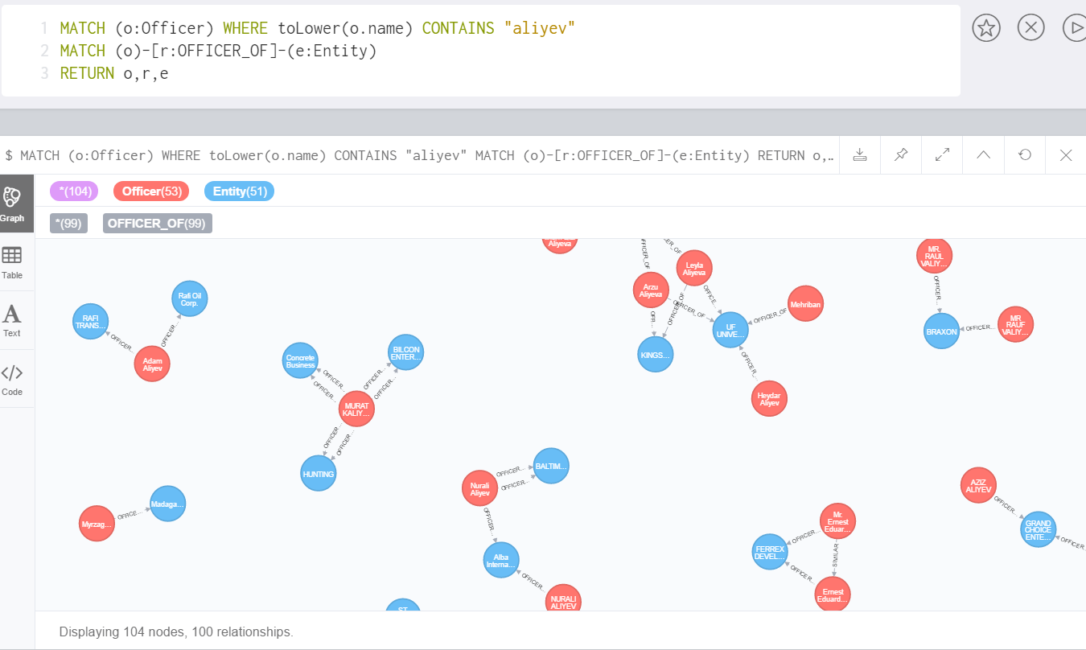
Paradise Papers
Here, we explore another example regarding the President of Azerbaijan, Ilham Aliyev. Using the above query we explore all offshore connections of the Aliyev family.
MATCH (o:Officer) WHERE toLower(o.name) CONTAINS "aliyev" MATCH (o) – [r:OFFICER_OF] – (e:Entity) RETURN o,r,e

Slide 46
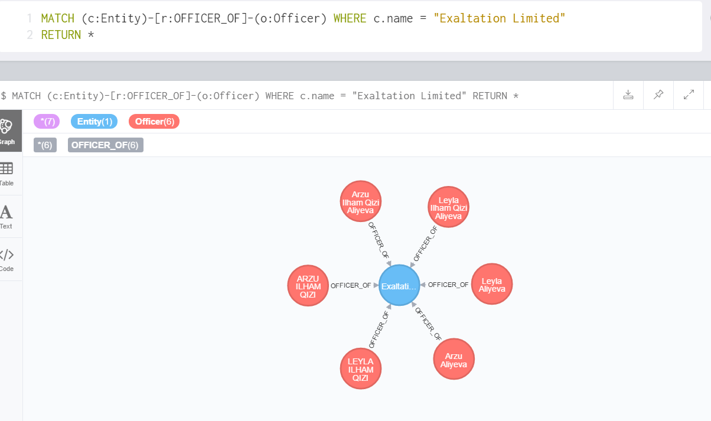
Paradise Papers
Here, we pick one of the entities explored previously and see all the Officers/beneficiaries connected to it. We see that the Aliyev family seems to be the primary beneficiary.
MATCH (c:Entity) – [r:OFFICER_OF] – (o:Officer) WHERE c.name = "Exaltation Limited" RETURN *

Slide 47
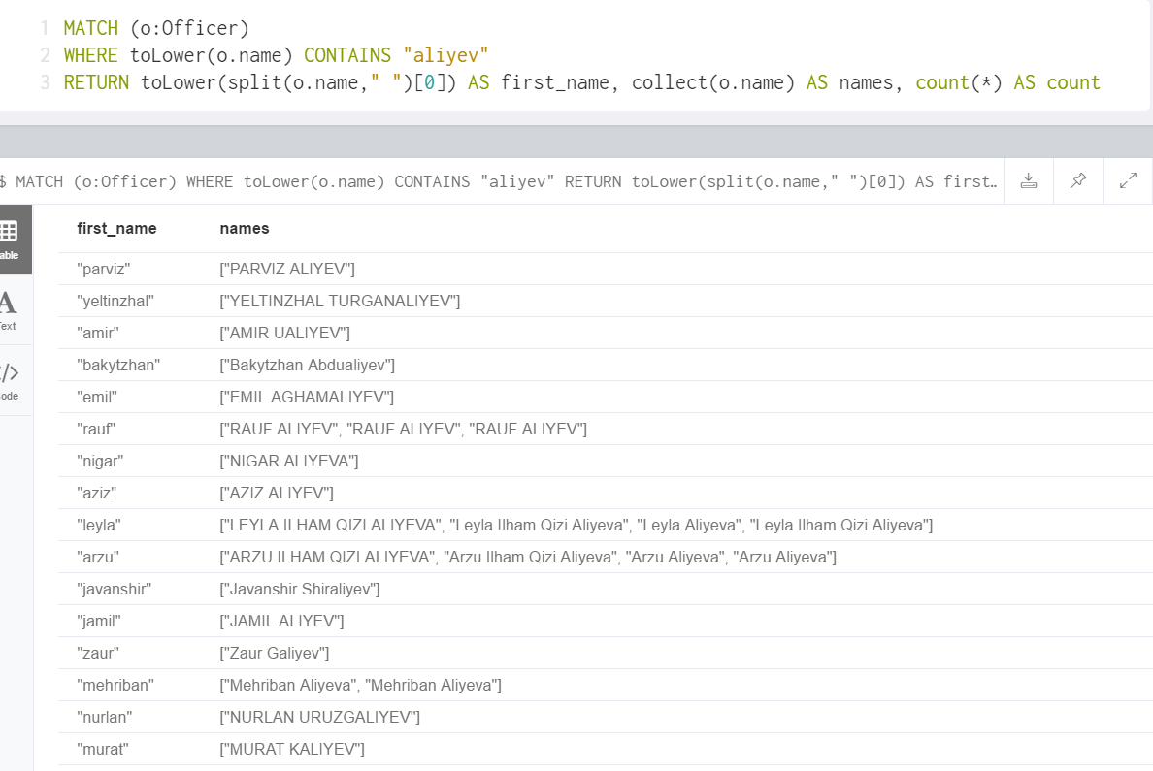
Paradise Papers
Since there are duplicates present in the Paradise Papers dataset, we use the above query to return a list of all possible duplicates for the Aliyev family.
MATCH (o:Officer) WHERE toLower(o.name) CONTAINS "aliyev" RETURN toLower(split(o.name, " " )[0]) AS first_name, collect(o.name) AS names, count(*) AS count

Slide 48
Panama Papers
Similar to the Paradise Papers that we have been exploring, there exists another database – the Panama Papers – consisting of ~2.6TB of information regarding offshore connections.
The zip file containing the network data (in csv format) for the Panama Papers can be downloaded from the Offshore Leaks Database site (mentioned earlier): https://offshoreleaks.icij.org/pages/database
We will discuss one of the examples explored earlier – The President of Azerbaijan, Ilham Aliyev – in greater detail using the Panama Papers.

Slide 49
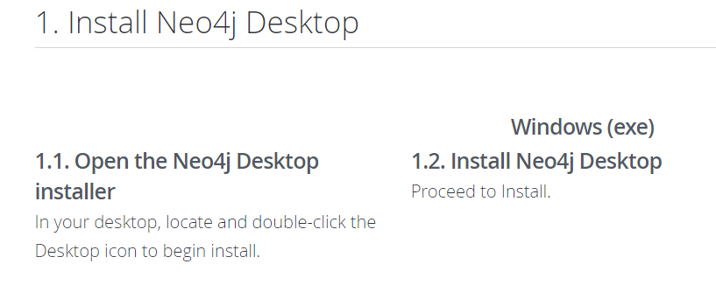
Panama Papers
First, we begin by installing the Neo4j desktop application and creating a database, where we will later load the Panama Papers dataset.
Please follow the instructions to proceed with the installation:
Link: https://neo4j.com/download/

Slide 50
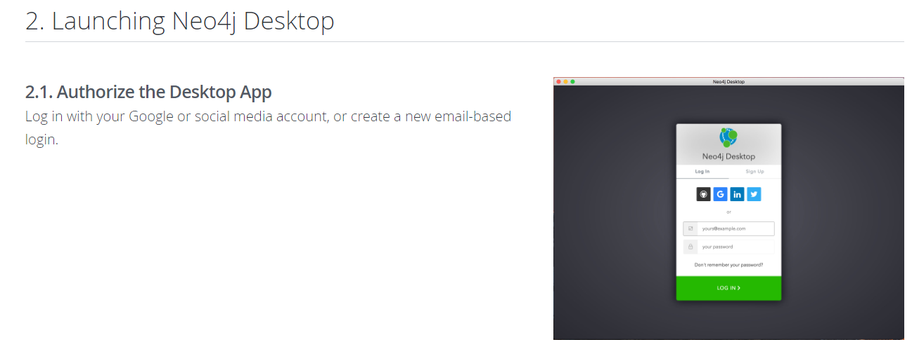
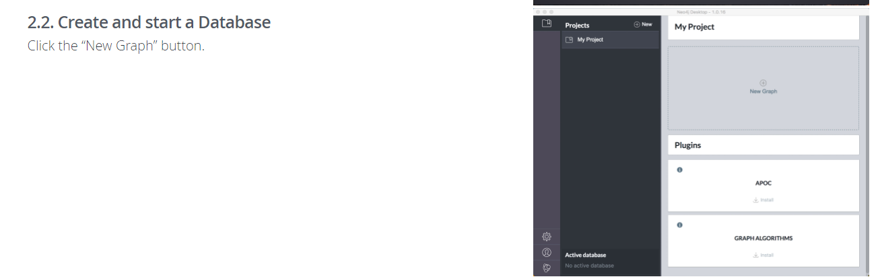
Panama Papers
Create a new database as follows:

Slide 51
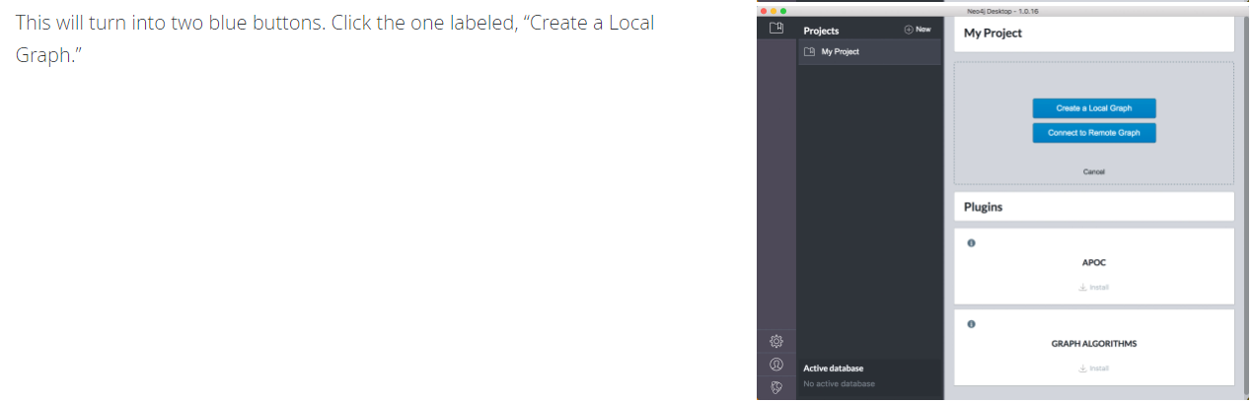
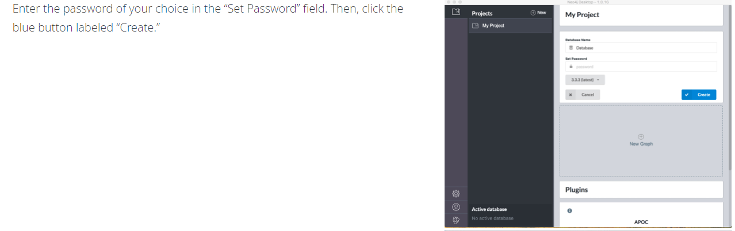
Panama Papers
Create a new database as follows:

Slide 52
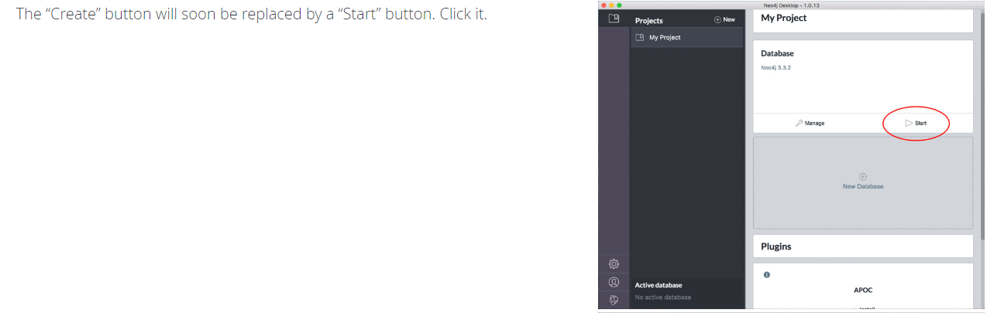
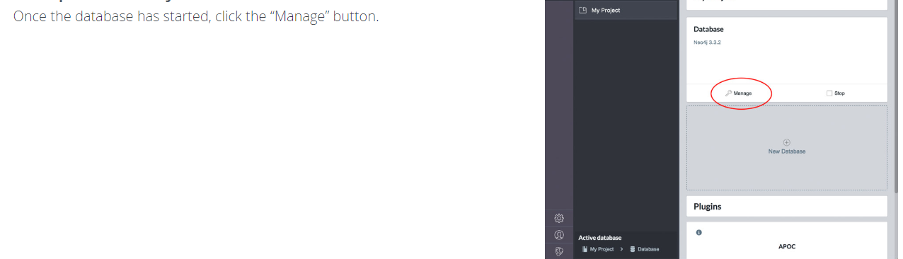
Panama Papers
Start the database and open Neo4j browser:

Slide 53


Panama Papers
Start the database and open Neo4j browser:

Slide 54

Panama Papers
You can also install plugins using the plugins tab. APOC, GRAPH ALGORITHMS and GraphQL are the different plugins available with Neo4j.

Slide 55

Panama Papers
Click on “Manage” and install plugins from the Plugins tab.

Slide 56


Panama Papers
You are now ready to run different Cypher queries on your own Neo4j database.
Open the browser and use it to run queries.
In case a query runs for too long, you may terminate it using the following Cypher statements (available only on Enterprise version > 3.1)
Queries on how to load the data are inspired from https://www.prgarnett.net/panama-papers-import-data-to-neo4j-using-cypher/

Slide 57


Panama Papers
Now, unzip the downloaded Panama Papers database and place it in the “import” location for your Neo4j desktop.
To access the import location, click “Manage”, use the arrow next to Open Folder and click on Import.
Place all the csv files in the import folder which opens up.

Slide 58




Slide 59

Clean files
In address and officer files, there are some special character “\” right in front of the closing quotation mark“””, which is not allowed. Please delete it, then try to import again.
Please change “WANG LI\” to “WANG LI”

Slide 60



Panama Papers
To load the Address, Intermediary and Officer files, use the given queries.
using periodic commit load csv with headers from "file:/panama_papers.nodes.address.csv" as line create (:Addresses { address: line.address, name:line.name, valid_until: line.valid_until, country_codes: line.country_codes, countries: line.countries, node_id: toInt(line.node_id), sourceID: line.sourceID})
USING PERIODIC COMMIT LOAD CSV WITH HEADERS FROM 'file:/panama_papers.nodes.intermediary.csv' AS line CREATE (:Intermediaries { name: line.name, valid_until: line.valid_until, country_codes: line.country_codes, countries: line.countries, status: line.status, node_id: toInt(line.node_id), sourceID: line.sourceID})
USING PERIODIC COMMIT LOAD CSV WITH HEADERS FROM 'file:/panama_papers.nodes.officer.csv' AS line CREATE (:Officers { name: line.name, valid_until: line.valid_until, country_codes: line.country_codes, countries: line.countries, node_id: toInt(line.node_id), sourceID: line.sourceID})

Slide 61

Panama Papers
To load the Entity file use the query given below.
USING PERIODIC COMMIT LOAD CSV WITH HEADERS FROM 'file:/panama_papers.nodes.entity.csv' AS line CREATE (:Entities { name: line.name, jurisdiction: line.jurisdiction, jurisdiction_description: line.jurisdiction_description, country_codes: line.country_codes, countries: line.countries, incorporation_date: line.incorporation_date, inactivation_date: line.inactivation_date, struck_off_date: line.struck_off_date, closed_date: line.closed_date, status: line.status, company_type: line.company_type, service_provider: line.service_provider, ibcRUC: toInt(line.ibcRUC) , note: line.note, valid_until: line.valid_until, node_id: toInt(line.node_id), sourceID: line.sourceID})

Slide 62




Panama Papers
Create an index as follows for all node labels e.g. for Officers use CREATE INDEX ON :Officers(node_id);

Slide 63

Panama Papers
Then add the edges using the query (this query add Officers and Entities relationships)
USING PERIODIC COMMIT LOAD CSV WITH HEADERS FROM 'file:/panama_papers.edges.csv' AS input
MATCH (from:Officers {node_id: toInteger(input.START_ID)}), (to:Entities {node_id: toInteger(input.END_ID)})
CREATE (from)-[:RELATION {type: input.TYPE}]->(to);

Slide 64

Panama Papers
Then add the edges using the query (this query add Intermediaries and Entities relationships)
USING PERIODIC COMMIT LOAD CSV WITH HEADERS FROM 'file:/panama_papers.edges.csv' AS input
MATCH (from:Intermediaries {node_id: toInteger(input.START_ID)}), (to:Entities {node_id: toInteger(input.END_ID)})
CREATE (from)-[:RELATION {type: input.TYPE}]->(to);

Slide 65

Panama Papers
Then add the edges using the query (this query add Addresses and Entities relationships)
USING PERIODIC COMMIT LOAD CSV WITH HEADERS FROM 'file:/panama_papers.edges.csv' AS input
MATCH (from:Addresses {node_id: toInteger(input.START_ID)}), (to:Entities {node_id: toInteger(input.END_ID)})
CREATE (from)-[:RELATION {type: input.TYPE}]->(to);

Slide 66

Panama Papers
After all files are loaded, you can view the metadata as follows.

Slide 67

Panama Papers
We use the above query to visualize all nodes representing the Aliyev family.
MATCH (o:Officers) WHERE toLower(o.name) CONTAINS "aliyev" RETURN o

Slide 68

Panama Papers
We now see the different offshore entity relationships with the Aliyev family.
MATCH (o:Officers) WHERE toLower(o.name) CONTAINS "aliyev"
MATCH (o)-[r]-(c:Entities)
RETURN o,r,c

Slide 69

Panama Papers
As we have seen earlier, we again explore connections for the specific entity Exaltation Ltd. and observe the main beneficiaries as the Aliyev family.
MATCH (c:Entities) – [r] – (o:Officers) WHERE c.name = "Exaltation Limited" RETURN *

Slide 70


Panama Papers
Similar to before, we explore another offshore entity observed in the Aliyev’s network. We further click on the node, see its children nodes and discover an intermediary – Nautilus.
MATCH (c:Entities) – [r] – (o:Officers) WHERE c.name CONTAINS "KINGSV" RETURN *

Slide 71

Panama Papers
We now explore further regarding the connections of the intermediary Nautilus and find that it acts an as intermediary for a lot of offshore entities.
MATCH (c:Entities) – [r] – (o:Intermediaries) WHERE o.name CONTAINS "NAUTILUS" RETURN *

Slide 72



Panama Papers
Here, we explore all shortest paths between two relatives of the Aliyev family and obtain a common entity, which when expanded leads to an intermediary – Mossack. On exploring the children nodes for Mossack we see a similar network as earlier (a lot of offshore entities being managed through this intermediary).
MATCH (a:Officers {name: "Mehriban Aliyeva"}) MATCH (b:Officers {name: "Arzu Aliyeva"}) MATCH p=allShortestPaths((a) – [*] – (b)) RETURN p

Slide 73

Panama Papers
Here, we use another query for de-duplication, similar to the query used in the Paradise Papers, and obtain the unique name corresponding to all duplicate entries for the Aliyev family network.
MATCH (o:Officers) WITH split(toLower(o.name), " ") AS name_parts, o WITH name_parts[0] + " " + name_parts[-1] AS name, collect(o.name) AS names, count(*) AS count WHERE count > 1 AND name CONTAINS "aliyev" RETURN name, names, count ORDER BY count DESC

Slide 74

Panama Papers
Using the de-duplication query, we create new unique nodes for the Aliyev network and connect them to the already existing nodes using the relationship “IDENTITY”, indicating that all those nodes are identities of the given unique nodes.
MATCH (o:Officers) WITH split(toLower(o.name), " ") AS name_parts, o
WITH name_parts[0] + " " + name_parts[-1] AS name, collect(o) AS Officers
WHERE name CONTAINS "aliyev"
CREATE (p:Person {name:name})
FOREACH (o IN Officers | CREATE (o)-[:IDENTITY]->(p))

Slide 75

Panama Papers
CREATE (ilham:Person {name:"ilham aliyev"})
CREATE (heydar:Person {name:"heydar aliyev"})
WITH ilham, heydar
MATCH (mehriban:Person {name:"mehriban aliyeva"})
MATCH (leyla:Person {name:"leyla aliyeva"})
MATCH (arzu:Person {name:"arzu aliyeva"})
FOREACH (child in [leyla,arzu,heydar] | CREATE (ilham)-[:CHILD_OF]->(child) CREATE (mehriban)-[:CHILD_OF]->(child))
CREATE (leyla)-[:SIBLING_OF]->(arzu)
CREATE (leyla)-[:SIBLING_OF]->(heydar)
CREATE (arzu)-[:SIBLING_OF]->(heydar)
CREATE (ilham)-[:MARRIED_TO]->(mehriban)
We create some family relationships between different nodes in the Aliyev network using these queries.

Slide 76

Panama Papers
We can now see all the unique nodes for the Aliyev family connection.
The small network in the center shows all the family relationships added by us using the previous create queries.
MATCH (p:Person) RETURN p

Slide 77

Panama Papers
We can now use the connections created earlier to simultaneously visualize the family connections as well as connections to offshore entities for the Aliyev family.
MATCH (p:Person) WHERE p.name CONTAINS "aliyev" OPTIONAL MATCH (c:Entities)< - - (o:Officers) – [:IDENTITY] – (p) RETURN c,o,p

Slide 78



Panama Papers
As an additional example, we include the connections for the President of Argentina, Mauricio Macri.
We can see the same pattern here between offshore entities, intermediaries and the ultimate beneficiaries, as seen in earlier examples.
MATCH (o:Officers) WHERE toLower(o.name) CONTAINS "macri"
MATCH (o)-[r]-(c:Entities)
RETURN o,r,c

Slide 79

Panama Papers
We can also use different algorithms like Page Rank in order to determine the most influential entities, officers, etc.
PageRank is an algorithm that measures the transitive influence or connectivity of nodes.
It can be computed by either iteratively distributing one node’s rank (originally based on degree) over its neighbors or by randomly traversing the graph and counting the frequency of hitting each node during these walks.
CALL algo.pageRank(null, null, {write:true, writeProperty: 'pagerank_g'})

Slide 80

Panama Papers
We can now use Page Rank to visualize the most influential offshore entities.
MATCH (e:Entities) WHERE exists(e.pagerank_g) RETURN e.name AS entity, e.jurisdiction_description AS jurisdiction, e.pagerank_g AS pagerank ORDER BY pagerank DESC LIMIT 15

Slide 81
References
Neo4j ( https://neo4j.com/ )
ICIJ (https://offshoreleaks.icij.org/pages/database )
Importing Panama Papers using Cypher ( https://www.prgarnett.net/panama-papers-import-data-to-neo4j-using-cypher/ )
Michael Hunger’s blogs on Paradise and Panama Papers (https://neo4j.com/blog/contributor/michael-hunger/ )
Wikipedia- List of people named in the Panama Papers (https://en.wikipedia.org/wiki/List_of_people_named_in_the_Panama_Papers )
http://www.digitale-akademie.de/fileadmin/user_upload/graphentechnologien/Hunger_-_Investigating_the_Panama_Papers_Connections_with_Neo4j_-_Mainz.pdf

